Slide 1
Environmentally Affected Tree Growth using L-Systems and Voxels
Andrew Leeuwenberg

Slide 2
Content
Hypothesis & Aim
Methodology summary
Result
Discussion and Future work
Conclusion

Slide 3
Aim

Slide 4
Hypothesis
H¹ is that computer simulated plant development that is affected by their environment can be achieved by generating L-systems in a 3D voxel environment

Slide 5
Null Hypothesis
H⁰ is that computer simulated plant development that is affected by their environment cannot be achieved by generating L-systems in a 3D voxel environment.

Slide 6
Collision avoidance

Slide 7
Phototropism

Slide 8
Competition

Slide 9
Methodology summary

Slide 10
Grow L-System

Slide 11
Grow L-system
F…

Slide 12
Grow L-System
F[+…

Slide 13
Grow L-system
F[+F…

Slide 14
Grow L-System
F[+F][-F…

Slide 15
Grow L-System
F[+F[+F][-F]][-F[+F][-F]]…

Slide 16
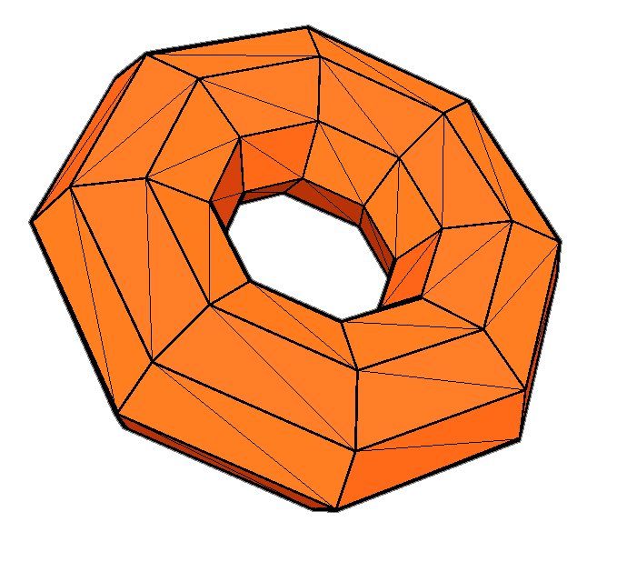
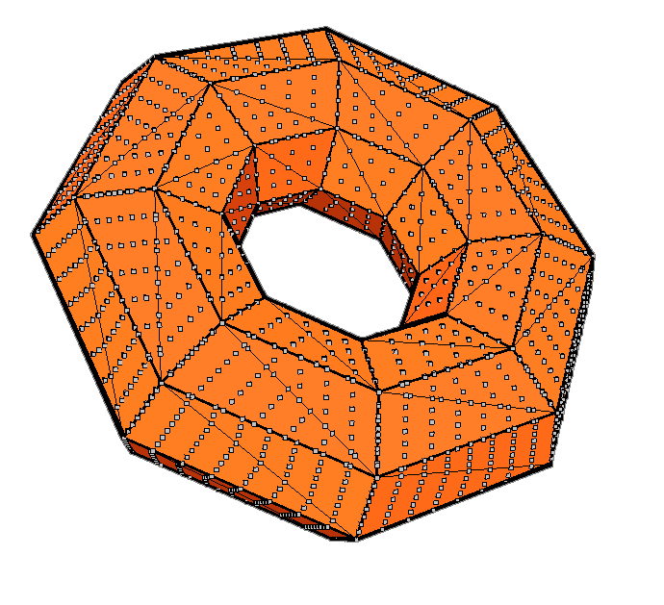
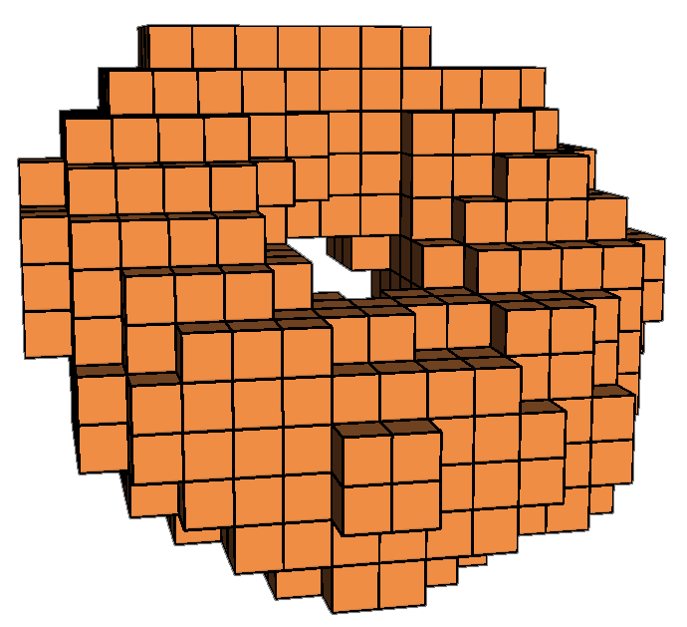
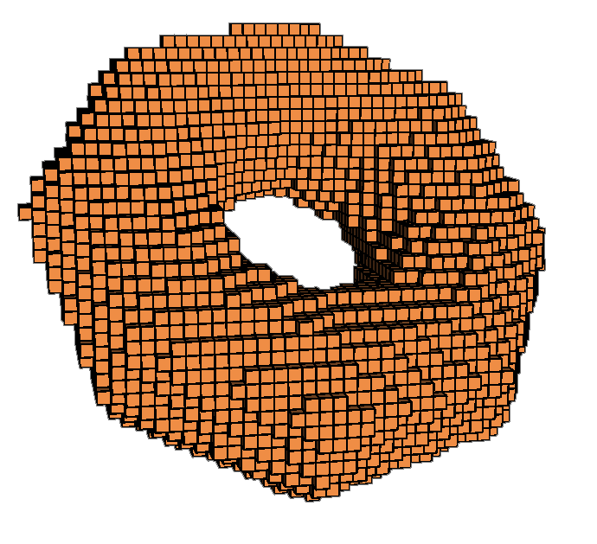
Collision avoidance

Slide 17
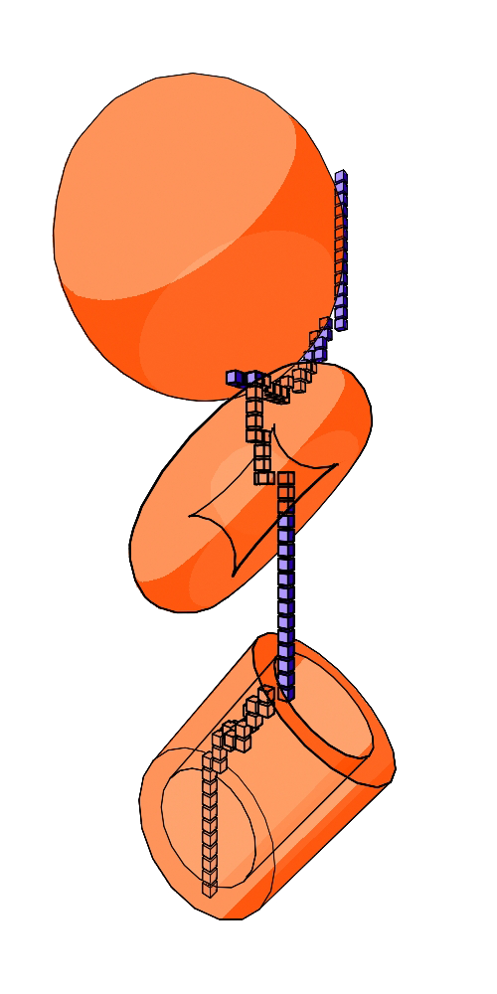
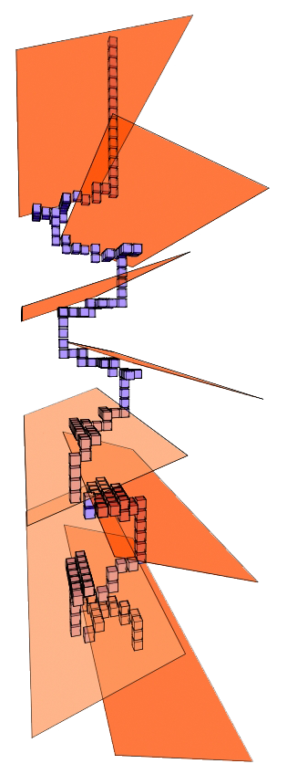
Collision avoidance

Slide 18
Luminosity

Slide 19
Luminosity
E = 4/7 ≈ 0.57

Slide 20
Luminosity
Adjust
Growth rate
Growth direction
Leaf growth
Leaf surface area

Slide 21
Original development
FF[+F[+X][-X]FX[-F[+X][-X]FX] FFF[+X][-X]FX

Slide 22
New development
FF[+F[+X][-X]FX[-F[+X][-X]FX] FFF[+X][-X]FX

Slide 23
Multiple trees
treeList
branchInfo
branchInfo
drawIndex
drawIndex
treeList
*head
*temp
*head
*temp
*next
branchInfo
drawIndex
MString
int
float
branchInfo
L-string
id
matrix[16]
…growth variables
*next
MIntArray
drawIndex
indexList
*next

Slide 24
Multiple trees

Slide 25
Result

Slide 26
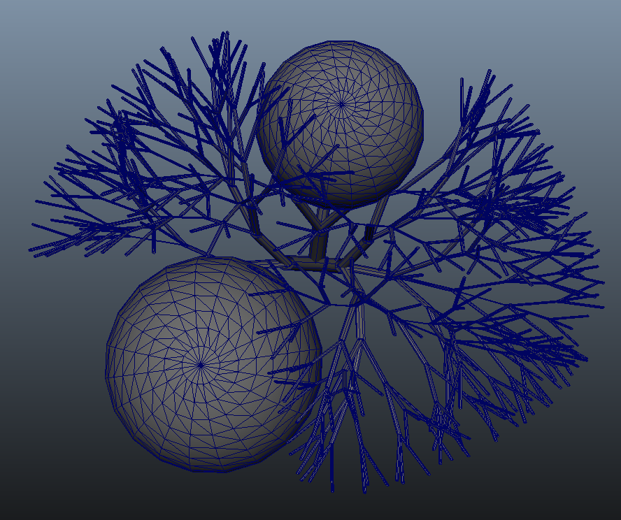
Collision avoidance

Slide 27
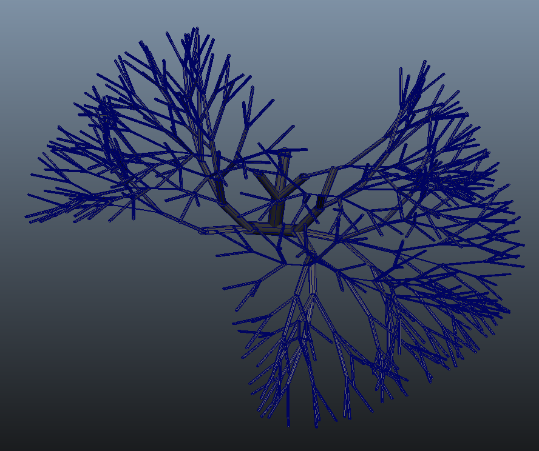
Collision avoidance

Slide 28
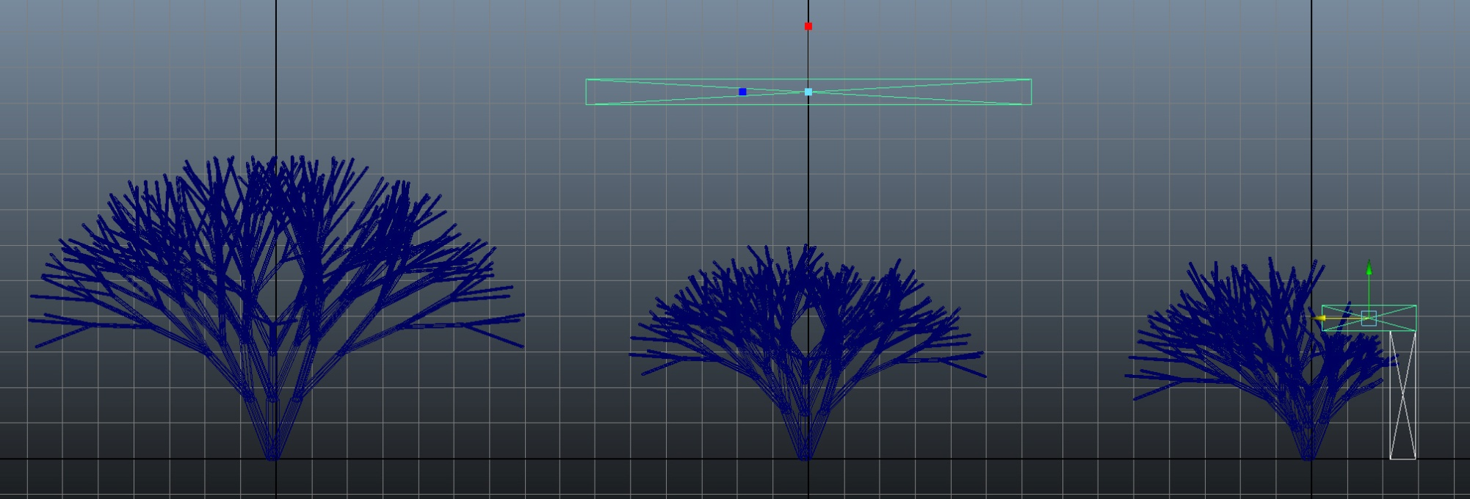
Phototropism

Slide 29
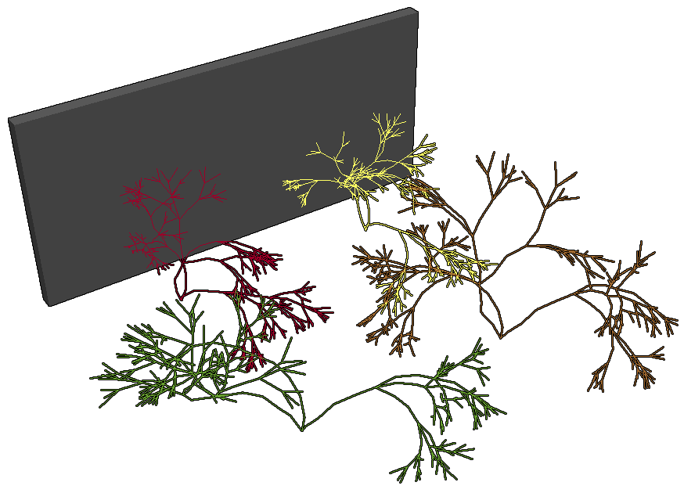
Competition

Slide 30
Discussion and Future Work

Slide 31
Stem structure

Slide 32
Stem structure
Bracketed OL-system implemented
Limited:
Not stochastic
Self-similar
More advanced Partial L-systems
Stochastic
Reduced self-similarity
Re-writing separate from growth
Method still valid

Slide 33
Phototropism (Rotations)

Slide 34
Current implementation
Calculate average luminosity (Ē)
North - South
East – West
Rotate towards greatest luminosity
 |  |  |  |  |  | N
 |  |  |  |  |  | E
 |  |  |  |  |  | E
 |  |  |  |  |  | E
 |  |  |  |  |  | E
 |  |  |  |  |  | E
W |  |  |  |  |  |  |  |  |  |  |  | E
 |  |  |  |  |  | S
Ē_{N}

Slide 35
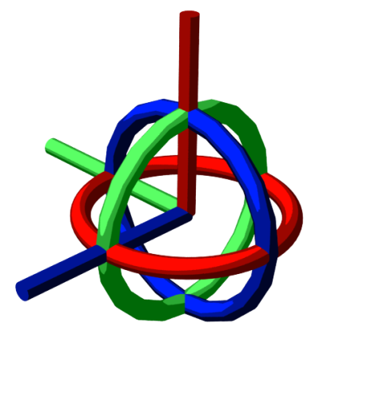
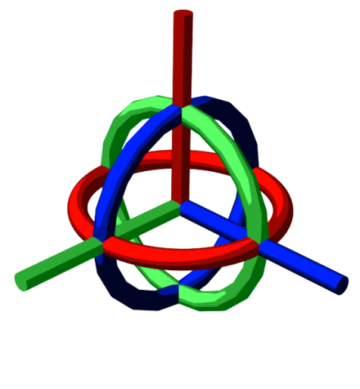
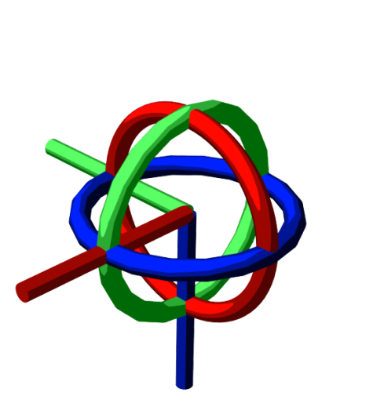
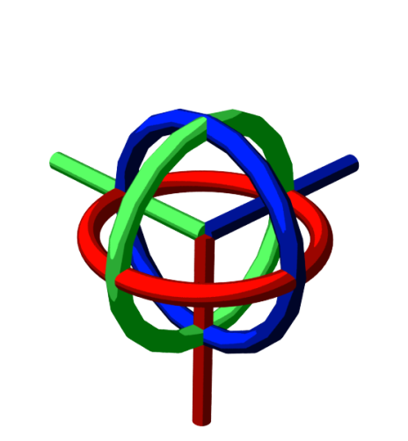
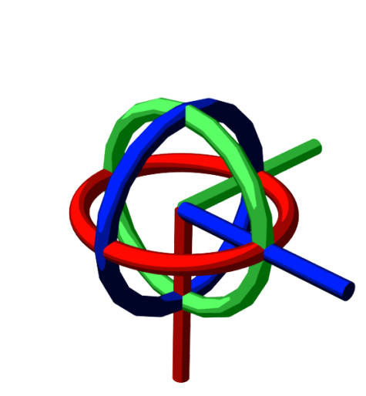
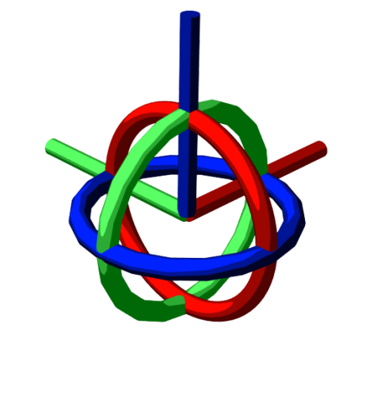
Euler rotation problem
X: 90° l.s.
X: 90° w.s.

Slide 36
Euler rotation problem
X, Y, Z ?

Slide 37
Quaternions
Slerp

Slide 38
Luminosity direction
Improve phototropism

Slide 39
Luminosity direction

Slide 40
Luminosity direction

Slide 41
Luminosity direction

Slide 42
Real-time

Slide 43
Separating the processes

Slide 44
Maya.cmds
Generate tree 01
Generate tree 02
Generate
L-string
Voxelize collision geometry
Return results
Generate tree 03
Generate tree 04

Slide 45
Maya.node
Generate
L-string
Generate tree 01
Generate
L-string
Generate tree 02
Voxelize collision geometry
Update results
Generate tree 03
Generate
L-string
Generate tree 04
Generate
L-string

Slide 46
Maya.node
Generate
L-string
Generate tree 01
Generate
L-string
Generate tree 02
Voxelize collision geometry
Update results
Generate tree 03
Generate
L-string
Generate tree 04
Generate
L-string

Slide 47
Maya.node
Generate
L-string
Generate tree 01
Generate
L-string
Generate tree 02
Voxelize collision geometry
Update results
Generate tree 03
Generate
L-string
Generate tree 04
Generate
L-string

Slide 48
Competition
Generate
L-string
Generate tree 01
Generate
L-string
Growth
manager
Generate tree 02
Voxelize collision geometry
Update results
Generate tree 03
Generate
L-string
Generate tree 04
Generate
L-string

Slide 49
Factors affecting speed
Axiom length
Successor length
L-string length
L-string interpretation
Generations
Growth time

Slide 50
Factors affecting speed
Number of samples
Voxel Size
Topology
Luminosity
Voxilizing geometry

Slide 51
Voxels

Slide 52
The effect of increased rays and voxel size on luminosity values
Luminosity

Slide 53
The RSD value when comparing voxel size and number of rays to calculate lumination
Luminosity

Slide 54
Luminosity

Slide 55
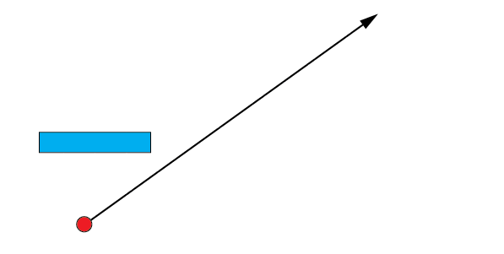
Luminosity

Slide 56
Spatial enumeration
0
1
0
0
1
1
0
0

Slide 57
Octrees
1
1
1
1
0
1
0
0
1
0
0
1
1
0
0

Slide 58
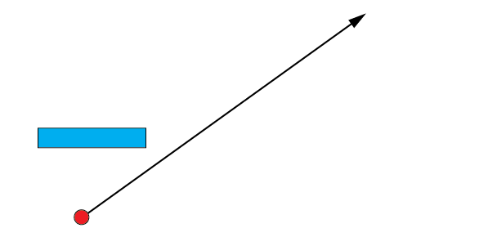
Luminosity

Slide 59
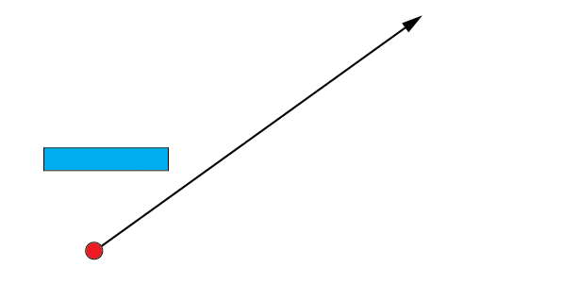
Luminosity

Slide 60
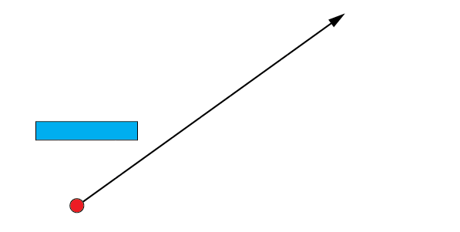
Luminosity

Slide 61
Luminosity

Slide 62
Luminosity

Slide 63
Luminosity

Slide 64
Luminosity

Slide 65
Luminosity

Slide 66
Luminosity

Slide 67
Luminosity

Slide 68
Luminosity

Slide 69
Voxilising geometry

Slide 70
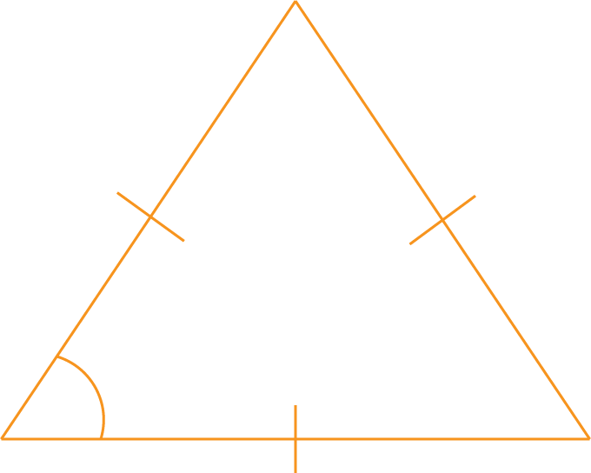
Current method
60°

Slide 71
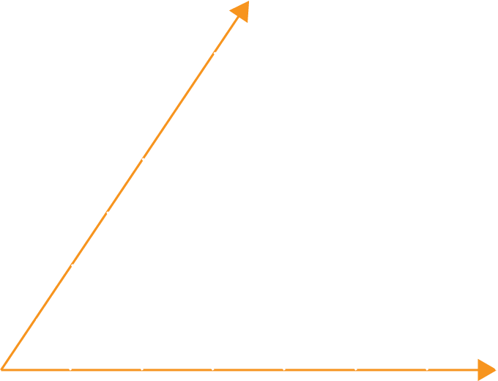
Current method

Slide 72
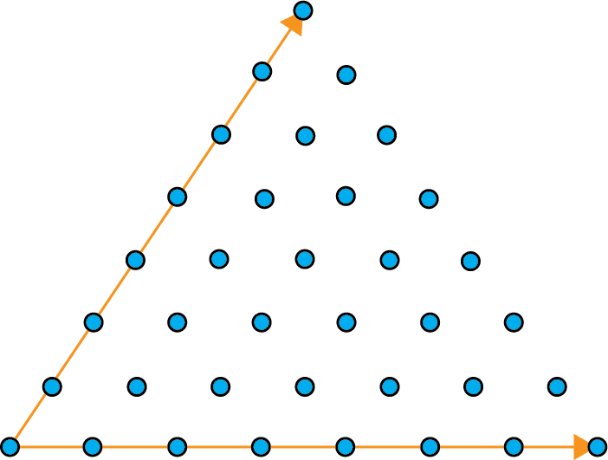
Current method

Slide 73
Problem

Slide 74
Problem

Slide 75
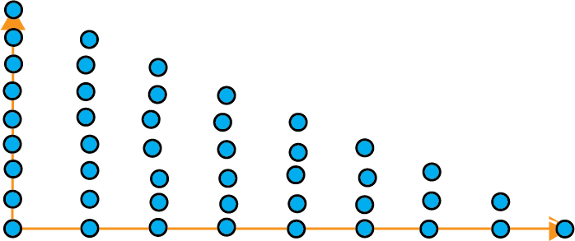
Problem

Slide 76
Problem

Slide 77
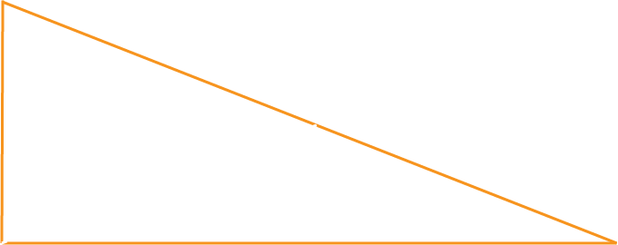
Solution
$d=4$
$h=8$
$$h$$
$$d$$

Slide 78
Solution

Slide 79
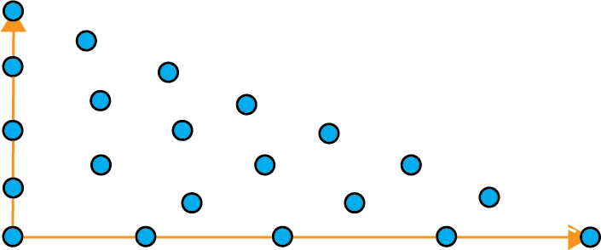
Solution

Slide 80
Conclusion

Slide 81
Conclusion
H¹ is that computer simulated plant development that is affected by their environment can be achieved by generating L-systems in a 3D voxel environment.
H⁰ is that computer simulated plant development that is affected by their environment cannot be achieved by generating L-systems in a 3D voxel environment.

Slide 82
Future Work

Slide 83
Proposed workflow
Adjust
results
Input variables
Compute
Proxy
output
Final
result

Slide 84
Summary
Hypothesis & Aim
Methodology summary
Result
Discussion and Future work
Conclusion

Slide 85
References
Prusinkiewicz, P., & Lindenmayer, A. (1990). The Algorithmic Beauty of Plants. New York: Springer-Verlag.
Greene, N. (1989). Voxel Space Automata: Modelling with Stochastic Growth Processes in Voxel Space. SIGGRAPH '89 Proceedings of the 16th annual conference on Computer graphics and interactive techniques , 23 (3), 175 – 184.
G, Marsaglia. (1972). Choosing a point from the surface of a sphere. The Annals of Mathematical Statistics. 43, 2. p 645 – 646
D. Meagher. (1982). "Geometric Modeling Using Octree Encoding," Computer Graphics and Image Processing, vol. 19, pp. 129 - 147, 1982.

Slide 86
Questions please

