Slide 1
Environmentally Affected Tree Growth using L-Systems and Voxels
Andrew Leeuwenberg

Slide 2
Contents
Voxelising Objects
Collision & Avoidance
Phototropism
Ambient
Direct
Sorting L-String
Growing multiple trees
Project management

Slide 3
Summary of Intent
Dev-Test (proof of concept)

Slide 4
Collision avoidance

Slide 5
Phototropism

Slide 6
Competition

Slide 7
Voxelising Collision Object

Slide 8
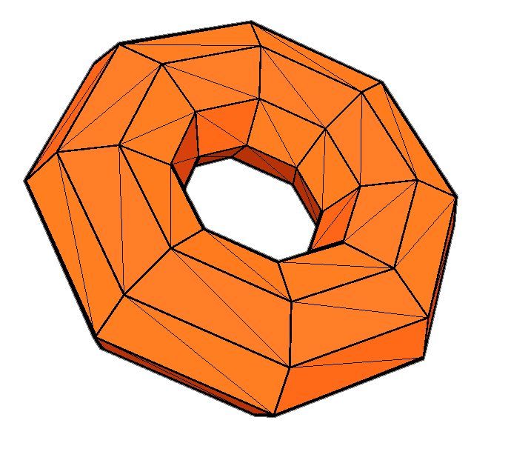

Slide 9
Mag^{max}:
|5|
|3|
|4|

Slide 10
Mag^{max}:
|5|
subDiv^{max}: Mag^{max} / voxelSize + 1

Slide 11
Mag^{max}:
|5|
subDiv^{max}: 6

Slide 12
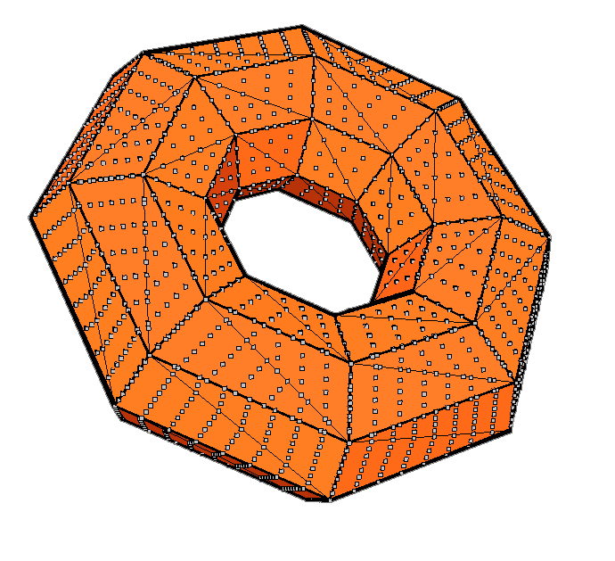

Slide 13
Getting Voxel Index
ScatterPoint = P_{xyz}
Define voxelArea: Va[3]
VoxelArray[Va[0] * Va[1] * Va[2]]
Define a voxelCorner: Vc[3]
Define voxelSize: Vs
VoxelPoint (Vp[3]) = (P_{xyz} – Vc_{xyz}) / Vs
Index =
VoxelArray[Index]
Eg. 100, 60, 100
Eg. -10, -4, -10
Eg. 1.0f
(Vp[1] * (Va[0] * Va[2])) +
(Vp[2] * Va[0]) +
Vp[0]

Slide 14
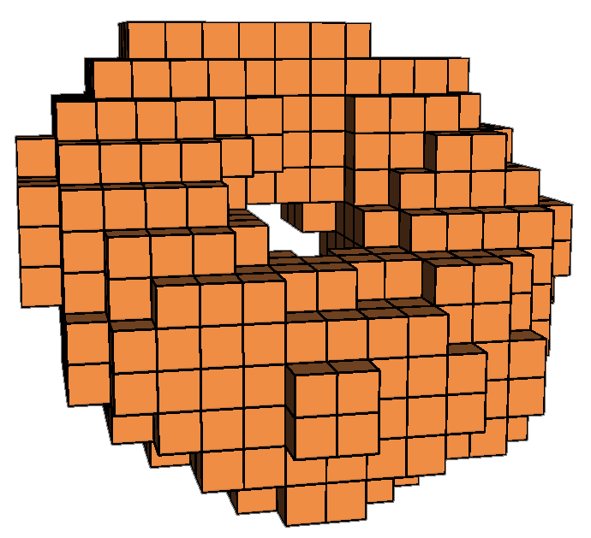

Slide 15
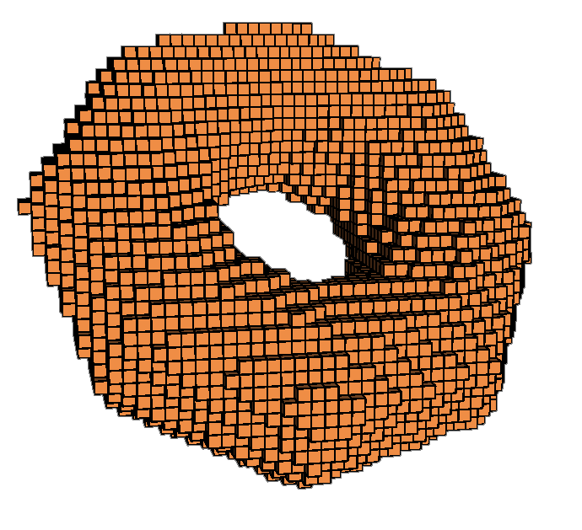
4:20

Slide 16
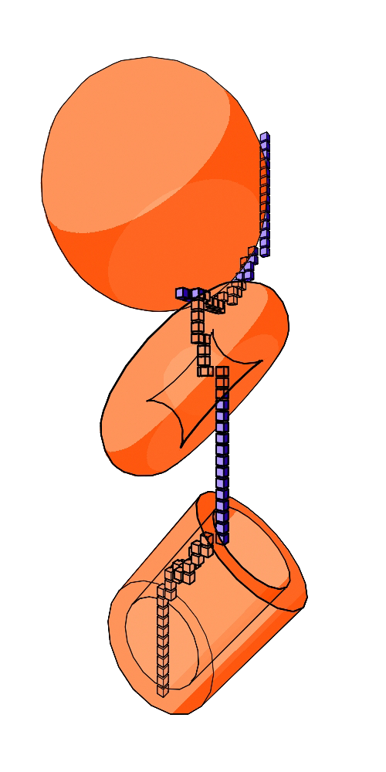
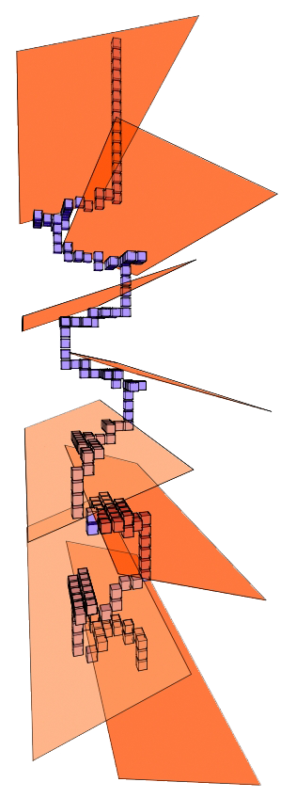
Path finding using voxels

Slide 17
When growing a branch
[
[
[
[
[
[
[
[
1 voxel unit

Slide 18
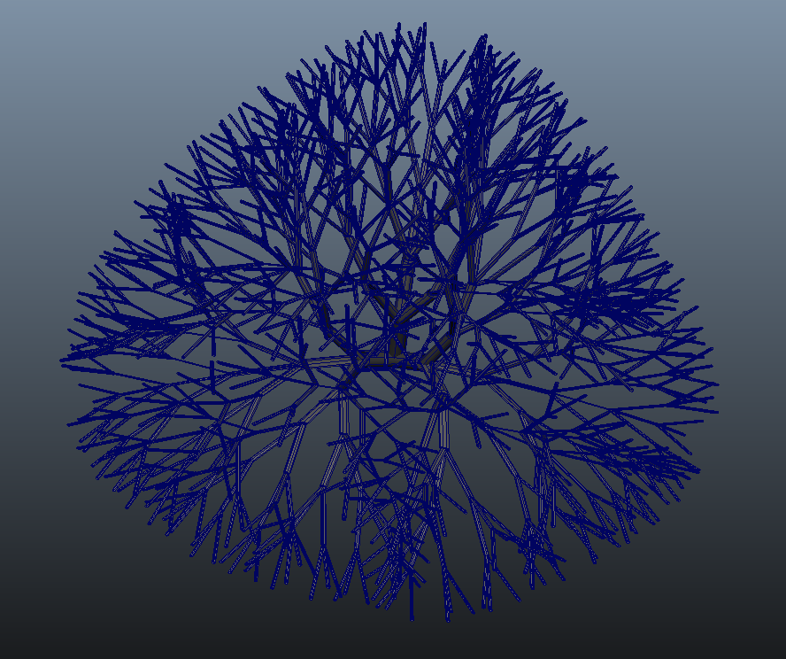

Slide 19
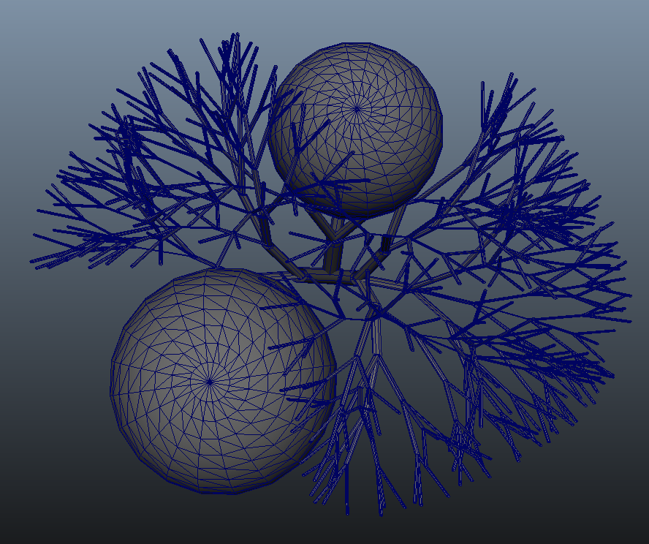

Slide 20
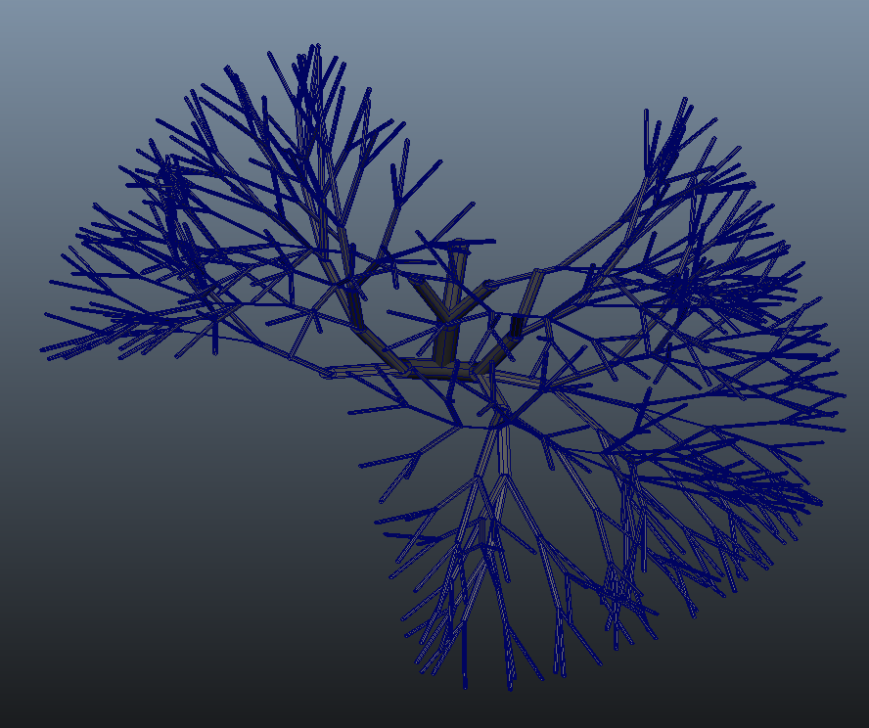

Slide 21
Collision avoidance

Slide 22
Collision avoidance

Slide 23
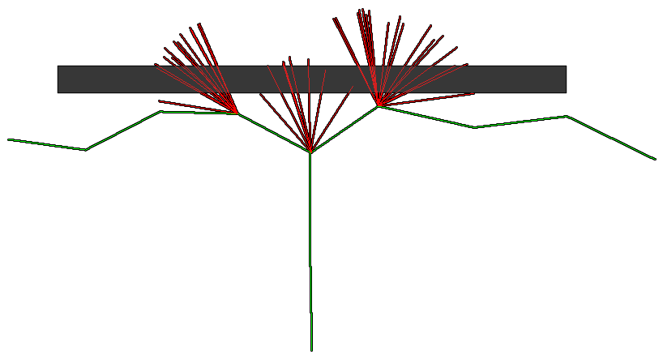
Collision avoidance

Slide 24
Phototropism

Slide 25
Phototropism
Calculated : “F” call
Affects :
Growth rate
Growth direction
Leaf growth
Leaf surface area

Slide 26
Luminosity

Slide 27
Ambient (E_{amb} )

Slide 28
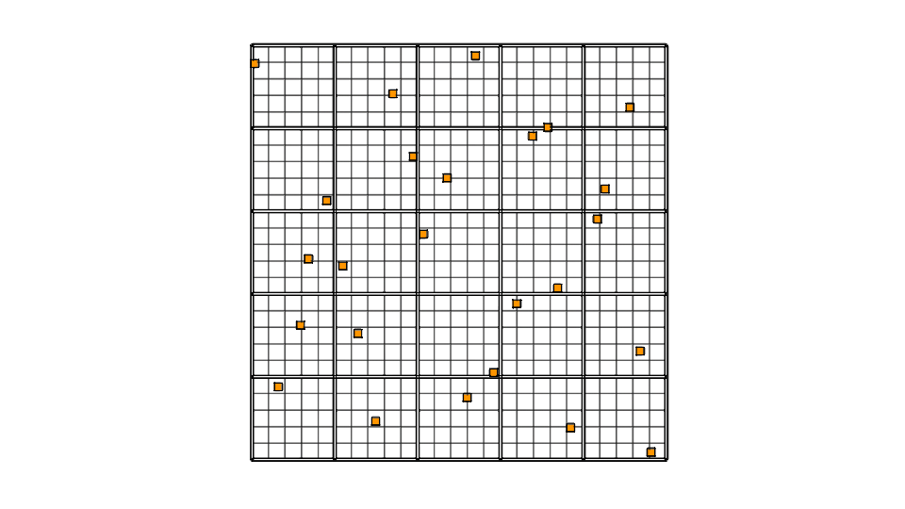
N-Rooks

Slide 29
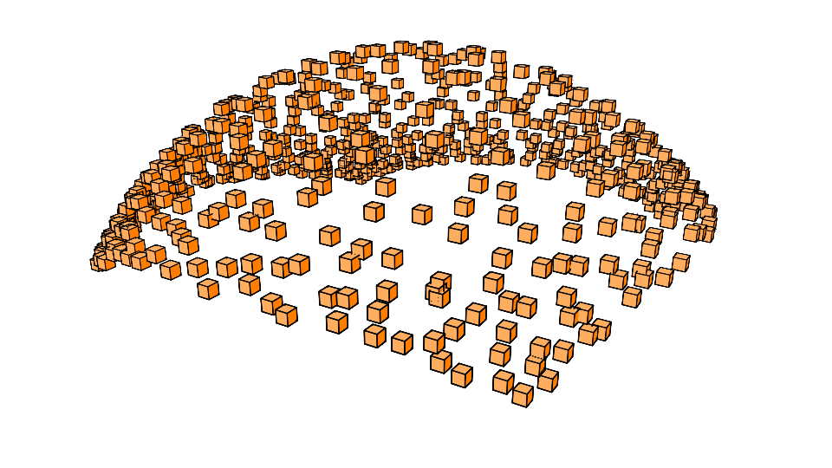
N-Rooks - Normalized

Slide 30
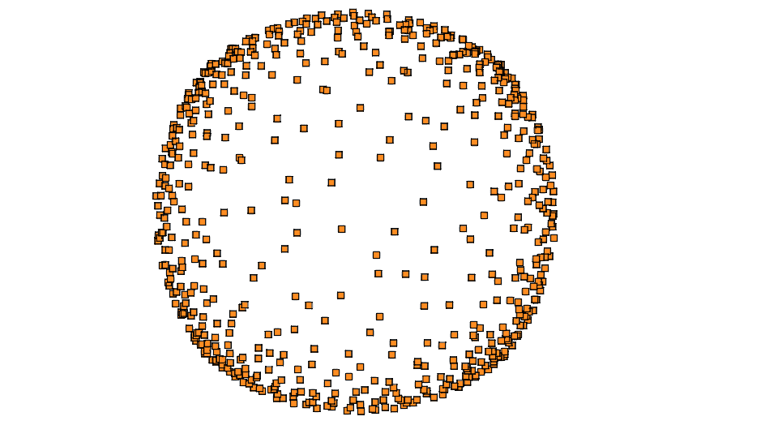
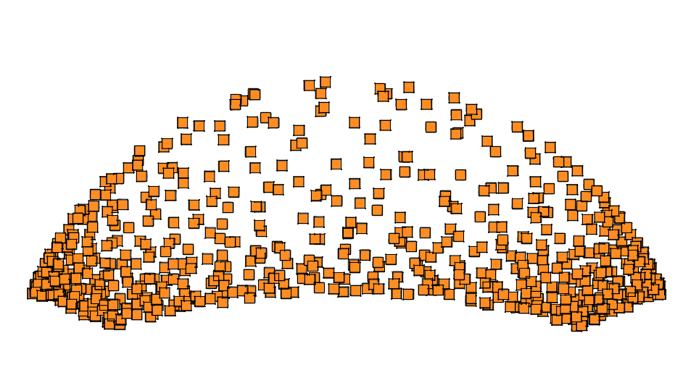
N-Rooks - Normalized
Side Top

Slide 31
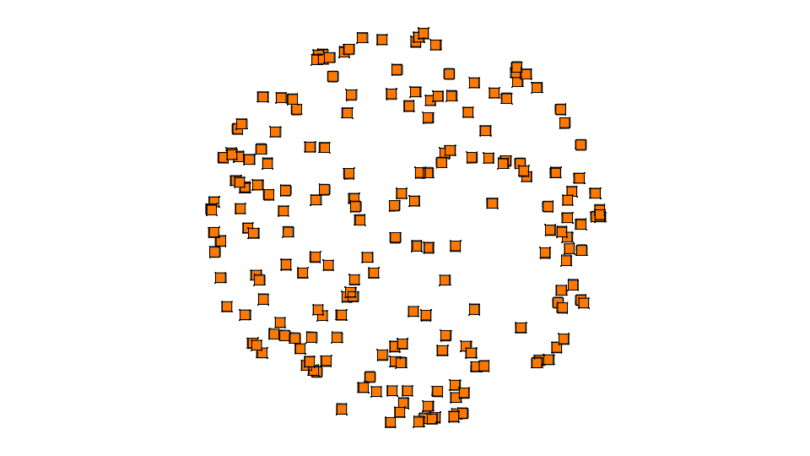
Marsaglias Spherical Scatter
V₁ ~U([-1,1])
V₂ ~U([-1,1])
S = V₁² + V₂² < 1
X = 2V₁ ( 1-S )^{1/2}
Y = 2V₂ ( 1-S )^{1/2}
Z = 1 - 2S

Slide 32
Marsaglias Spherical Scatter
V₁ ~U([-1,1])
V₂ ~U([ 0,1])
S = V₁² + V₂² < 1
X = 2V₁ ( 1-S )^{1/2}
Y = 2V₂ ( 1-S )^{1/2}
Z = 1 - 2S

Slide 33
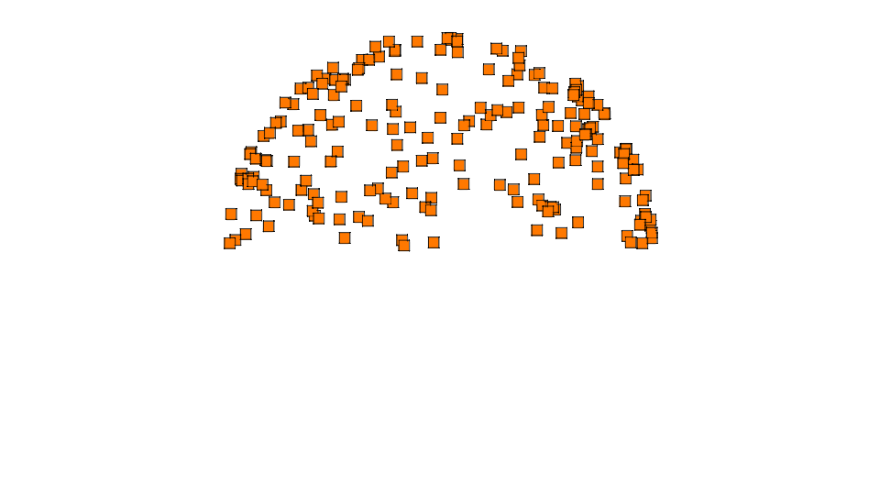
Marsaglias Spherical Scatter
V₁ ~U([-1,1])
V₂ ~U([ 0,1])
S = V₁² + V₂² < 1
X = 2V₁ ( 1-S )^{1/2}
Y = 2V₂ ( 1-S )^{1/2}
Z = 1 - 2S

Slide 34
How many sample points (n = 20) ?
 |  | Rays
VoxelSize |  | 10 | 50 | 100 | 200 | 1000 | 10000
Mean | (0.25) | 0.425 | 0.308 | 0.355 | 0.310 | 0.327 | 0.330
σ_{mean} | (0.25) | 0.133 | 0.051 | 0.025 | 0.036 | 0.015 | 0.006
Mean | (0.10) | 0.355 | 0.297 | 0.300 | 0.305 | 0.292 | 0.296
σ_{mean} | (0.10) | 0.095 | 0.071 | 0.045 | 0.034 | 0.014 | 0.005
Mean | (0.01) | 0.305 | 0.255 | 0.249 | 0.265 | 0.270 | 0.271
σ_{mean} | (0.01) | 0.182 | 0.060 | 0.046 | 0.031 | 0.015 | 0.004
 |  | Rays
VoxelSize |  | 10 | 50 | 100 | 200 | 1000 | 10000
RSD | (0.25) | 31.3 | 16.6 | 4.7 | 11.6 | 4.6 | 1.8
RSD | (0.10) | 26.8 | 23.9 | 15 | 11.1 | 4.8 | 1.7
RSD | (0.01) | 59.7 | 23.5 | 18.5 | 11.7 | 5.6 | 1.5

Slide 35
The effect of increased rays and voxel size on luminosity values

Slide 36
The effect of increased rays and voxel size on luminosity values

Slide 37
The RSD value when comparing voxel size and number of rays to calculate lumination

Slide 38
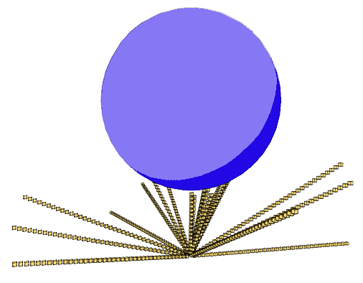
Ambient light
E_{amb} = R_{terminated} / R_{total}

Slide 39
Direct (E_{dir} )

Slide 40
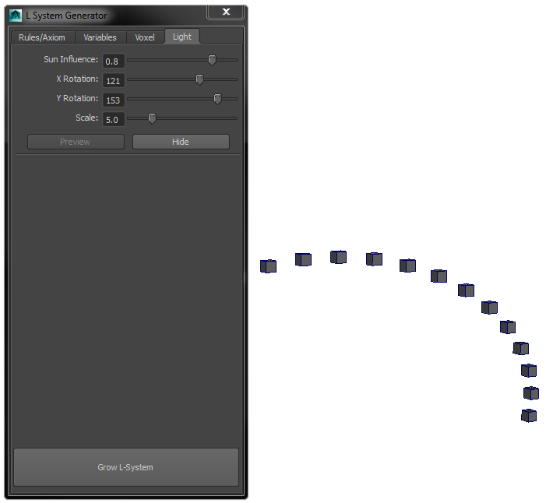
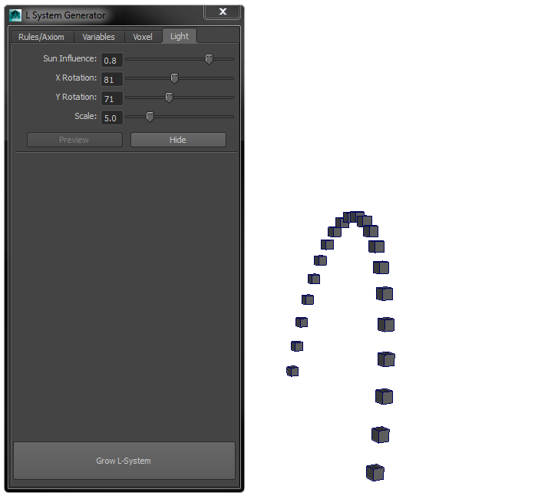
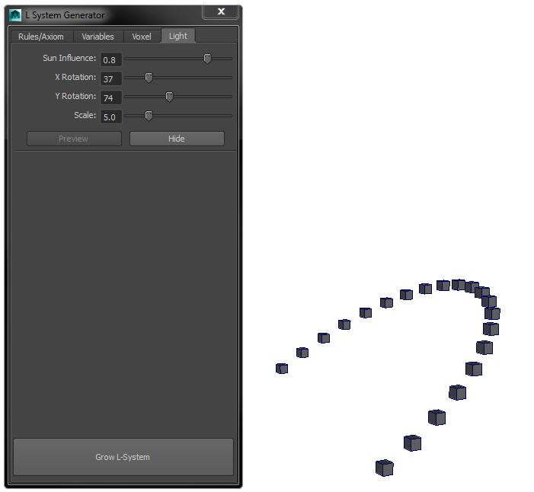
Sun Arch

Slide 41
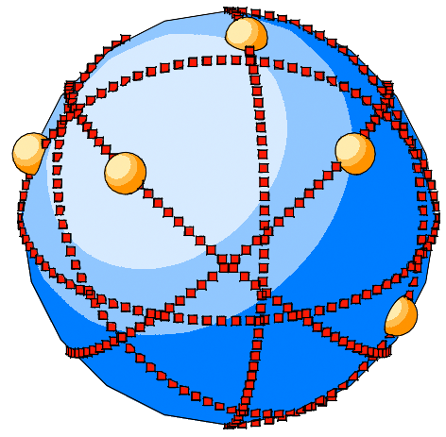
Sun Arch
E_{dir} = R_{terminated} / R_{total}

Slide 42
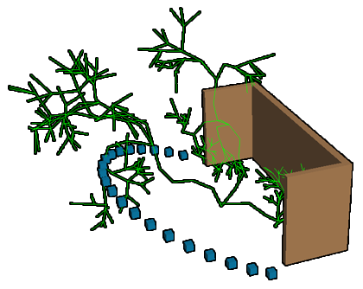
Luminosity
Sun Influence (Si) = 0 - 1
E_{total} = (E_{dir}* Si) + (E_{amb}* (1 –Si))
Si = 0.5

Slide 43
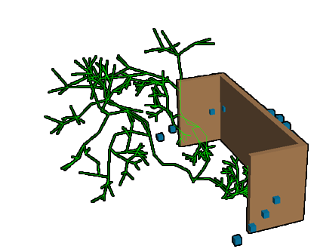
Luminosity
Sun Influence (Si) = 0 - 1
E_{total} = (E_{dir}* Si) + (E* (1 –Si))
Si = 0.1

Slide 44
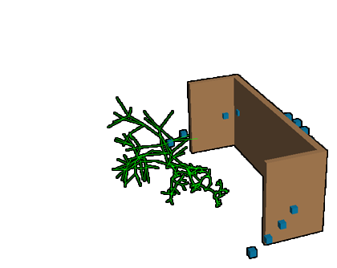
Luminosity
Sun Influence (Si) = 0 - 1
E_{total} = (E_{dir}* Si) + (E_{amb}* (1 –Si))
Si = 0.9

Slide 45
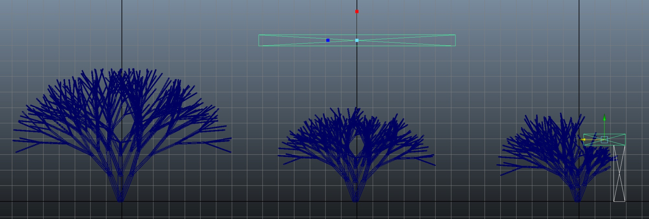
Growth rate

Slide 46
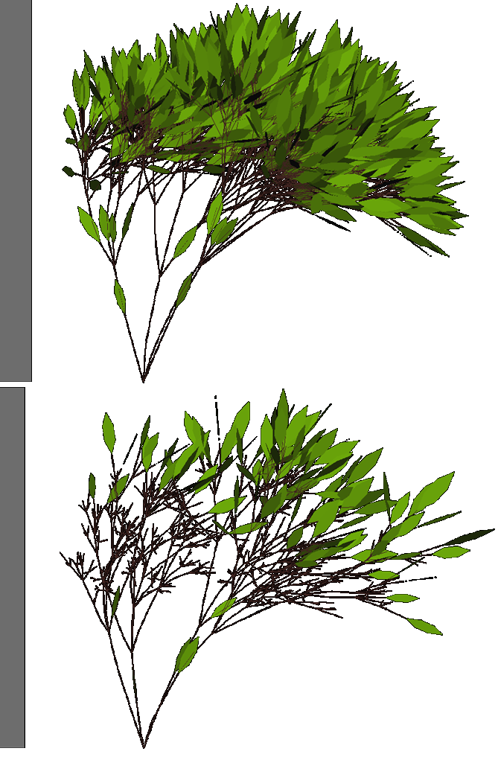
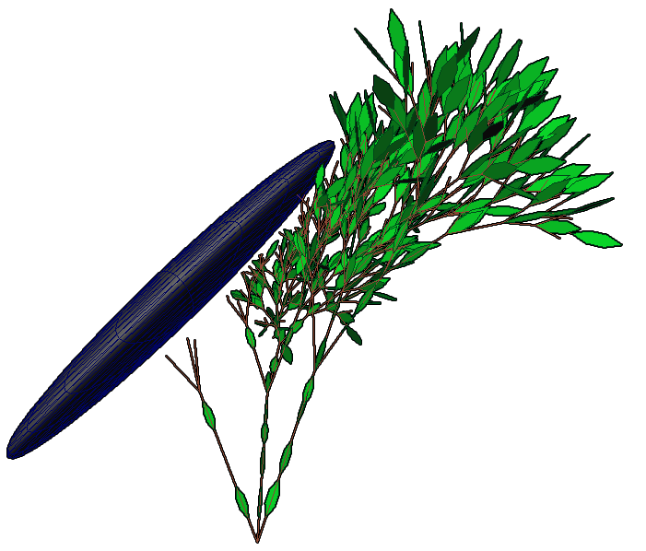
Leaf growth

Slide 47
E affecting growth direction

Slide 48
Rotation
Calculate average luminosity (Ē)
North - South
East - West
 |  |  |  |  |  | N
 |  |  |  |  |  | E
 |  |  |  |  |  | E
 |  |  |  |  |  | E
 |  |  |  |  |  | E
 |  |  |  |  |  | E
W |  |  |  |  |  |  |  |  |  |  |  | E
 |  |  |  |  |  | S
Ē_{N}

Slide 49
Rotation
Calculate average luminosity (Ē)
North - South
East - West
Max angle rotation = θ_{max}
For each axis:
Rotation θ = θ_{max} * (Ē_{max} – Ē_{min} )

Slide 50
Rotation
Calculate average luminosity (Ē)
North > South
East - West
Max angle rotation = θ_{max}
For each axis:
Rotation θ = θ_{max} * (Ē_{N max} – Ē_{S min} )

Slide 51
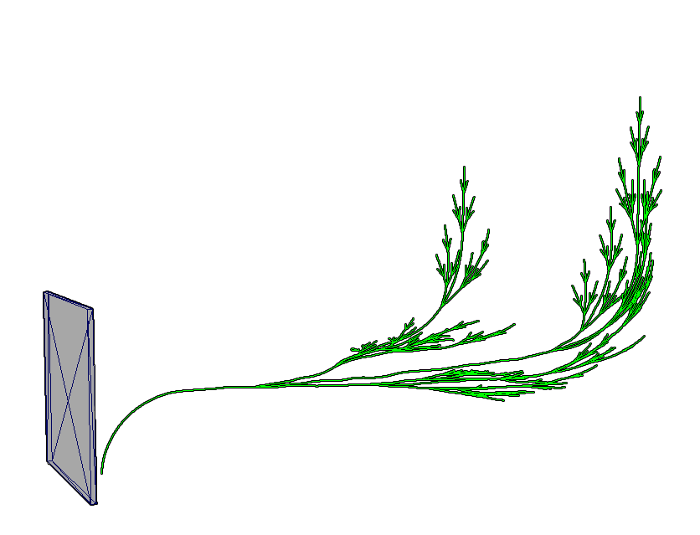
Rotation

Slide 52
Rotation
Calculate average luminosity
North / South
East / West
Max angle rotation = θ_{max}
For each axis:
Rotation θ = θ_{max} * ( E_{max} – E_{min} )

Slide 53
Sorting L-String

Slide 54
Problem with L-String
FF[+F[+X][-X]FX[-F[+X][-X]FX] FFF[+X][-X]FX

Slide 55
Sorting string
Child
0
1
2
[+F FX][-F FX] [+X][-X]
[+X][-X] [+X][-X]
FF FFF FX
Ω | ψ | Id | String
0 | -1 | 0 | FFFFFFX
2 | 0 | 1 | +FFX
2 | 0 | 2 | -FFX
5 | 0 | 3 | +X
5 | 0 | 4 | -X
Ω | Start time
ψ | Parent branch
Id | Identification num
String | Branch L-String
4 | 1 | 5 | +X
4 | 1 | 6 | -X
4 | 2 | 7 | +X
4 | 2 | 8 | -X

Slide 56
Sorting string
Ω | ψ | Id | String
0 | -1 | 0 | FFFFFFX
2 | 0 | 1 | +FFX
2 | 0 | 2 | -FFX
5 | 0 | 3 | +X
5 | 0 | 4 | -X
4 | 1 | 5 | +X
4 | 1 | 6 | -X
4 | 2 | 7 | +X
4 | 2 | 8 | -X
Ω | ψ | Id | String
0 | -1 | 0 | FFFFFFX
2 | 0 | 1 | +FFX
2 | 0 | 2 | -FFX
5 | 0 | 3 | +X
5 | 0 | 4 | -X
4 | 1 | 5 | +X
4 | 1 | 6 | -X
4 | 2 | 7 | +X
4 | 2 | 8 | -X

Slide 57
Sorting string
 |  |  | +FFX
 |  |  | -FFX
Ω | ψ | Id | String
0 | -1 | 0 | FFFFFFX
2 | 0 | 1
2 | 0 | 2
5 | 0 | 3
5 | 0 | 4
4 | 1 | 5
4 | 1 | 6
4 | 2 | 7
4 | 2 | 8
 |  |  | +X
 |  |  | -X
 |  |  | +X
 |  |  | -X
 |  |  | +X
 |  |  | -X
0
0
0 | 1 | 2
0 | 1 | 2
0 | 1 | 2 | 5 | 6 | 7 | 8
0 | 1 | 2 | 3 | 4 | 5 | 6 | 7 | 8
0 | 3 | 4

Slide 58
Sorting string
Ω | ψ | Id | String
0 | -1 | 0 | FFFFFFX
2 | 0 | 1
2 | 0 | 2
5 | 0 | 3 | +X
5 | 0 | 4 | -X
4 | 1 | 5 | +X
4 | 1 | 6 | -X
4 | 2 | 7 | +X
4 | 2 | 8 | -X
 |  |  | +FFX
 |  |  | -FFX
0
0
0 | 1 | 2
0 | 1 | 2
0 | 1 | 2 | 5 | 6 | 7 | 8
0 | 1 | 2 | 3 | 4 | 5 | 6 | 7 | 8
0 | 3 | 4

Slide 59
Sorting string
0
0
1 | 2 | 0
0 | 2 | 1
7 | 1 | 5 | 2 | 6 | 0 | 8
3 | 6 | 4 | 8 | 0 | 5 | 1 | 7 | 3
4 | 0 | 3

Slide 60
New L-String Interpretation
FF[+F[+X][-X]FX[-F[+X][-X]FX] FFF[+X][-X]FX

Slide 61
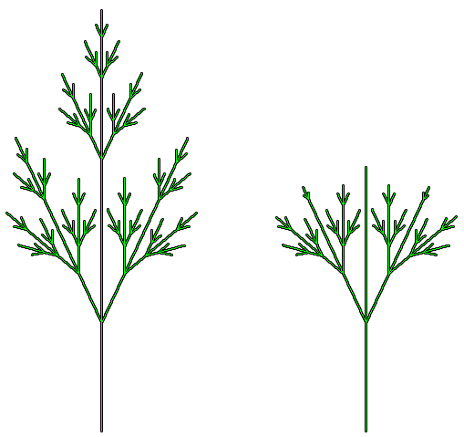
New L-String Interpretation

Slide 62
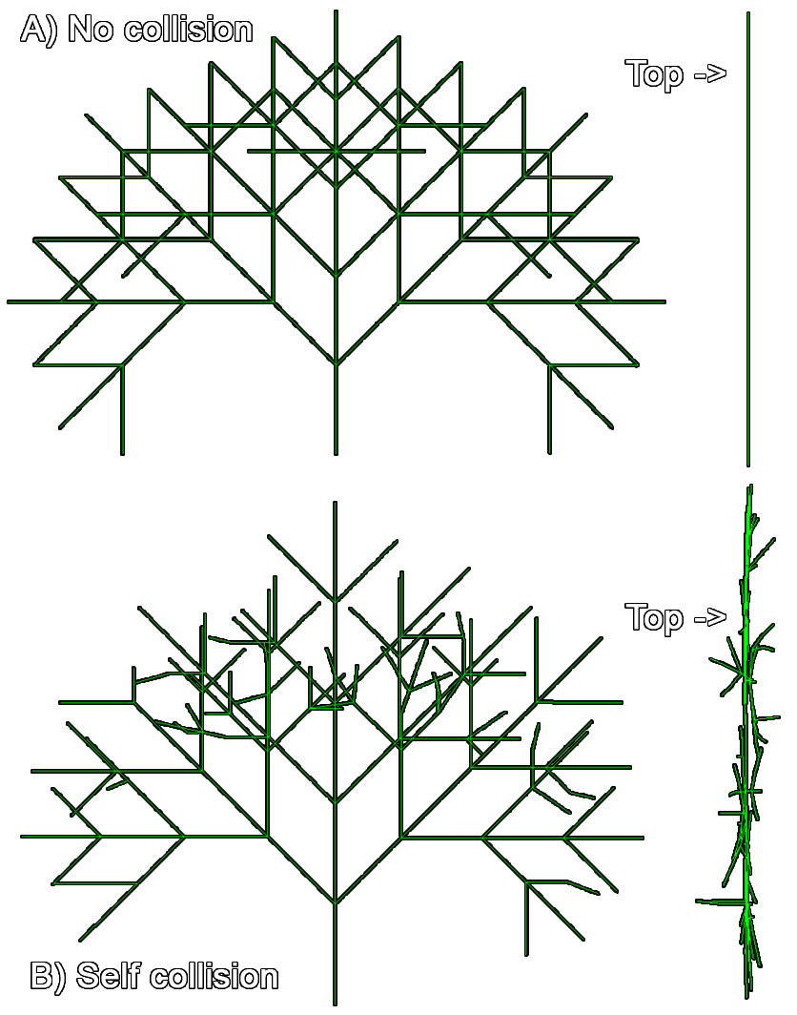
Self collision

Slide 63
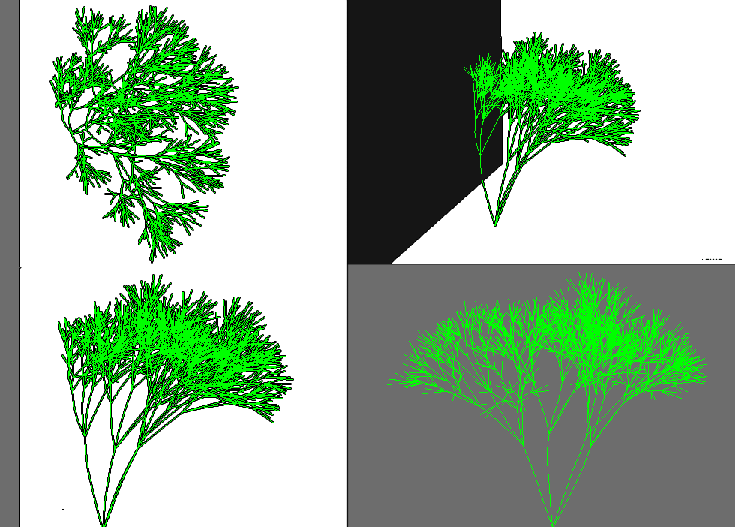
Geometry Occlusion & Collision

Slide 64
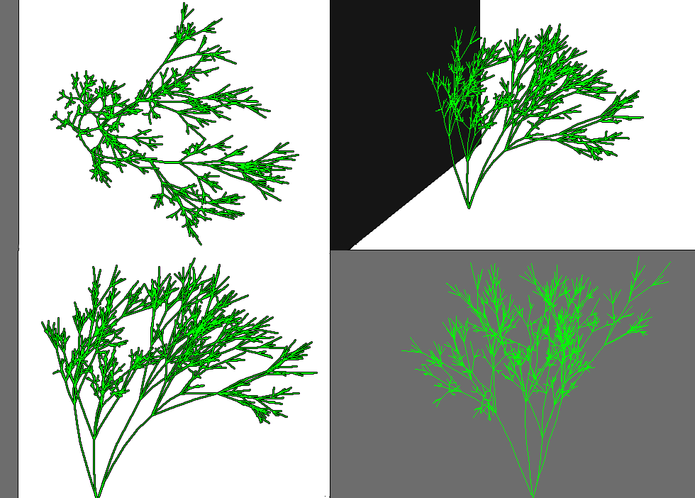
Geometry & Self-Occlusion & Collision

Slide 65
Growing Multiple Trees

Slide 66
Linked-Structures
treeList
branchInfo
branchInfo
drawIndex
drawIndex
treeList
*head
*temp
*head
*temp
*next
branchInfo
drawIndex
MString
int
float
branchInfo
L-string
id
matrix[16]
…growth variables
*next
MIntArray
drawIndex
indexList
*next

Slide 67
*head
*next
*temp

Slide 68
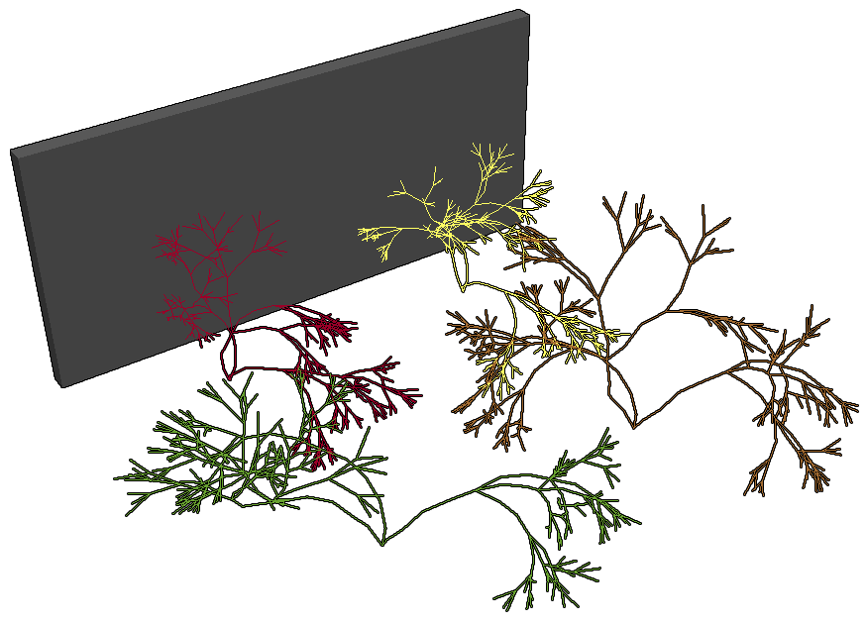

Slide 69
Next Stage

Slide 70
Next stage
Improve features
Simultaneous / staggered growth
Add usability control
Proxy visualisation
Experiments
Determined successful if:
3 behaviours achieved

Slide 71
Project management

Slide 72
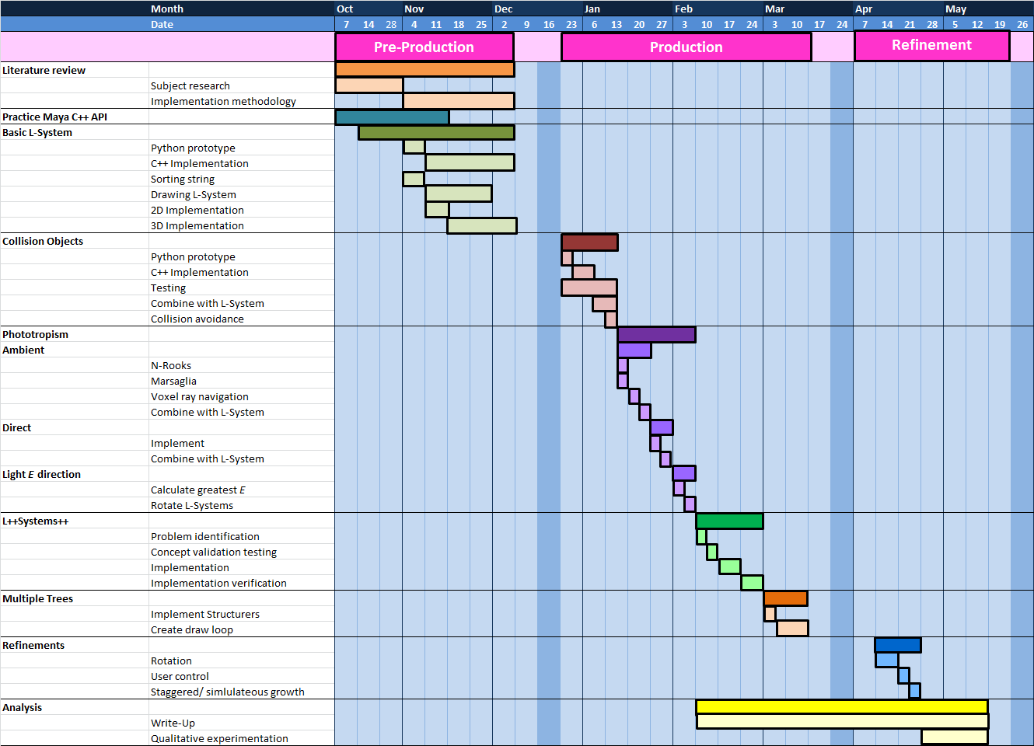
Gant chart

Slide 73
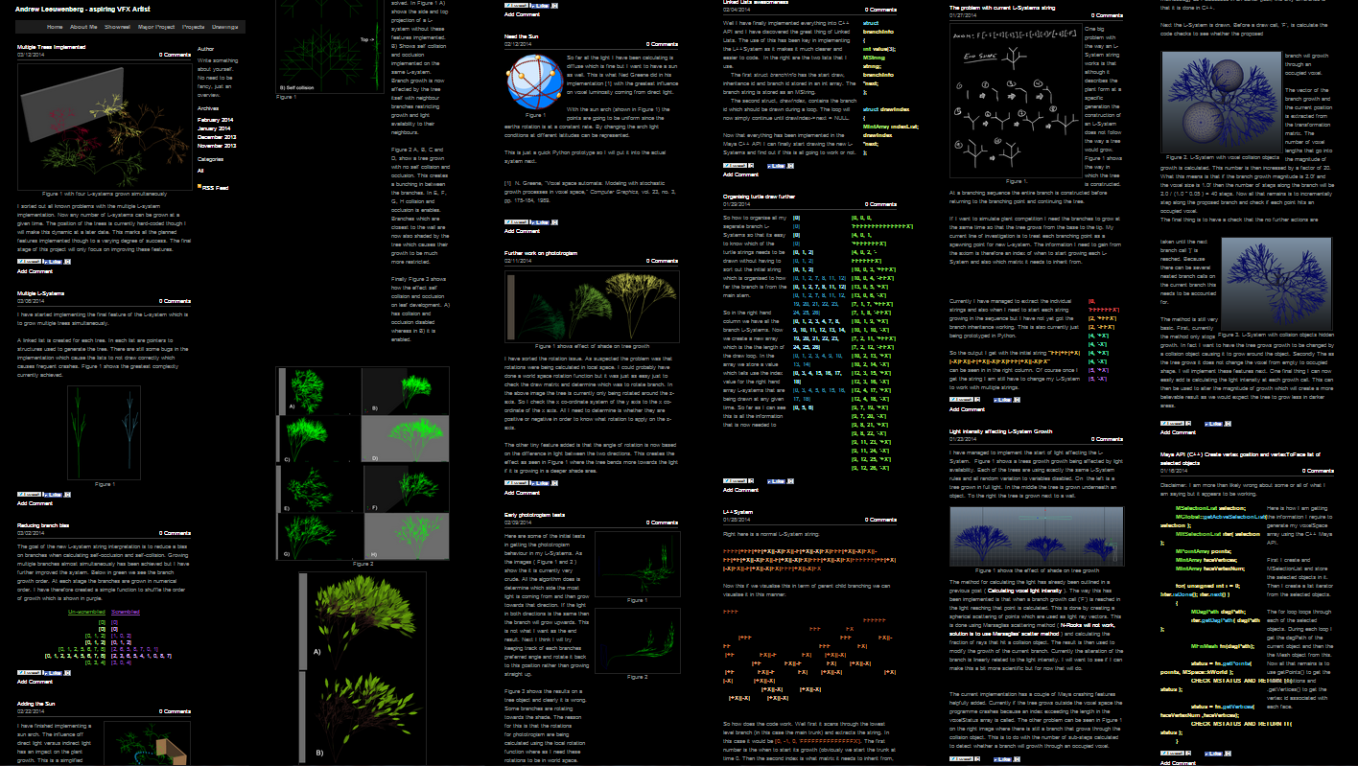
Blog – aleeuwenberg.com

Slide 74
Summary
Voxelising Objects
Collision & Avoidance
Phototropism
Ambient
Direct
Sorting L-String
Growing multiple trees
Project management
Next stage

Slide 75
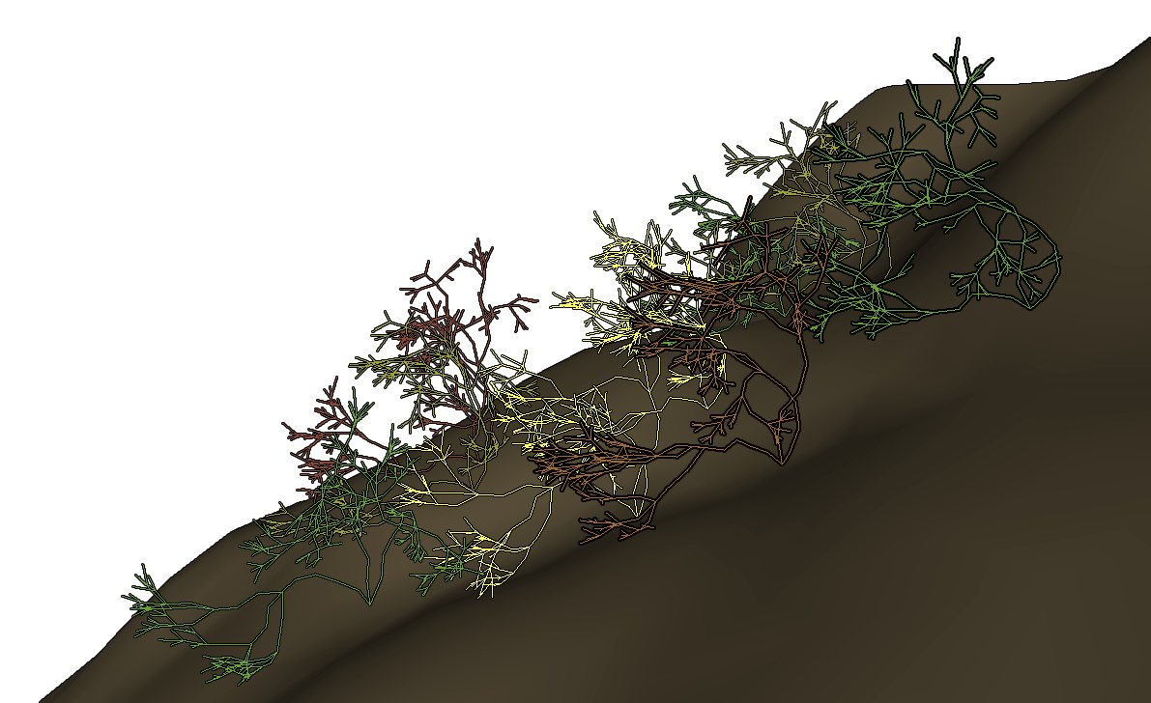
Questions please

Slide 76
References
Prusinkiewicz, P., & Lindenmayer, A. (1990). The Algorithmic Beauty of Plants. New York: Springer-Verlag.
Greene, N. (1989). Voxel Space Automata: Modelling with Stochastic Growth Processes in Voxel Space. SIGGRAPH '89 Proceedings of the 16th annual conference on Computer graphics and interactive techniques , 23 (3), 175 – 184.
Shirley, P. (1991). Discrepancy as a Quality Measure for Sample Distributions. Proceedings of Eurographics. 183-193
G, Marsaglia. (1972). Choosing a point from the surface of a sphere. The Annals of Mathematical Statistics. 43, 2. p 645 - 646

