Slide 1
Space and Photo sensitive L-Systems Andrew Leeuwenberg

Slide 2
Content
Rational
Project overview
Proposed method
Tree generation
Environmental impact
Coding
Current stage
Next stage

Slide 3
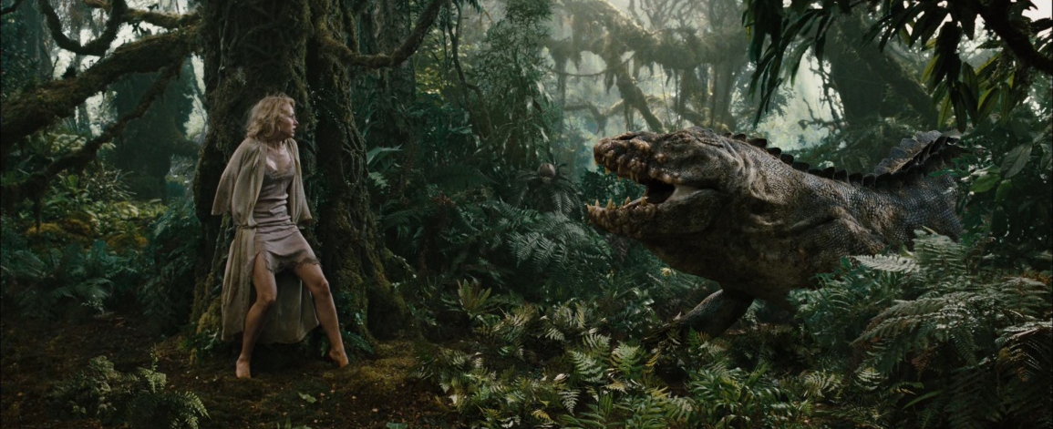
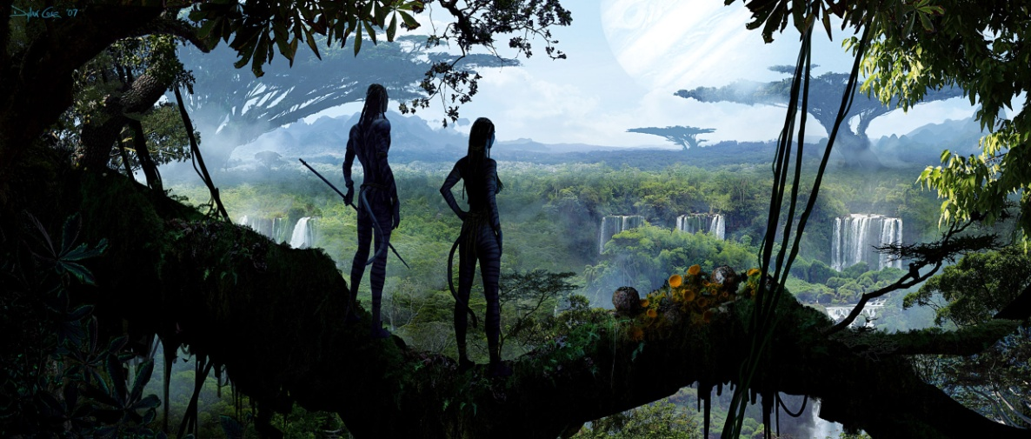
Rationale
CGI environments
King Kong (2005)
Avatar (2009)
Brave (2012)
Notes:
Here are some films with large scale CGI generated environmnets

Slide 4
Rationale
CGI environments
Procedural approach

Slide 5
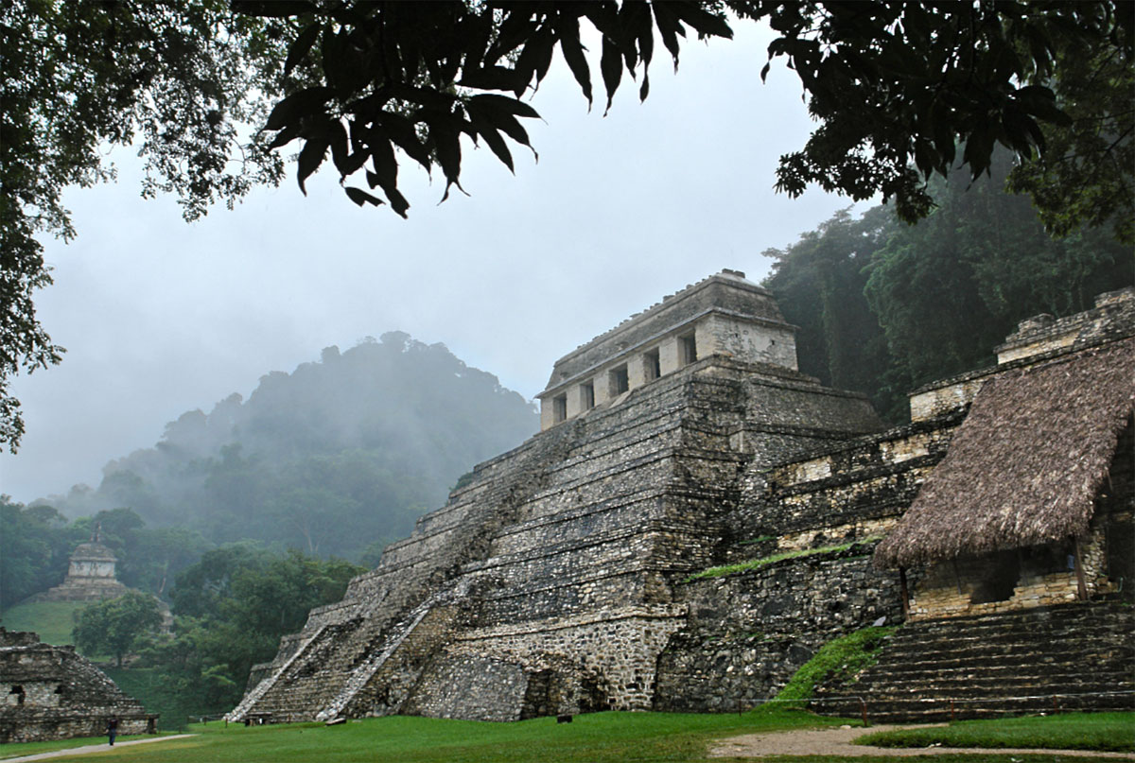
The Project

Slide 6
Project Statement
“To procedurally generate trees whose growth is affected by light and space availability”

Slide 7
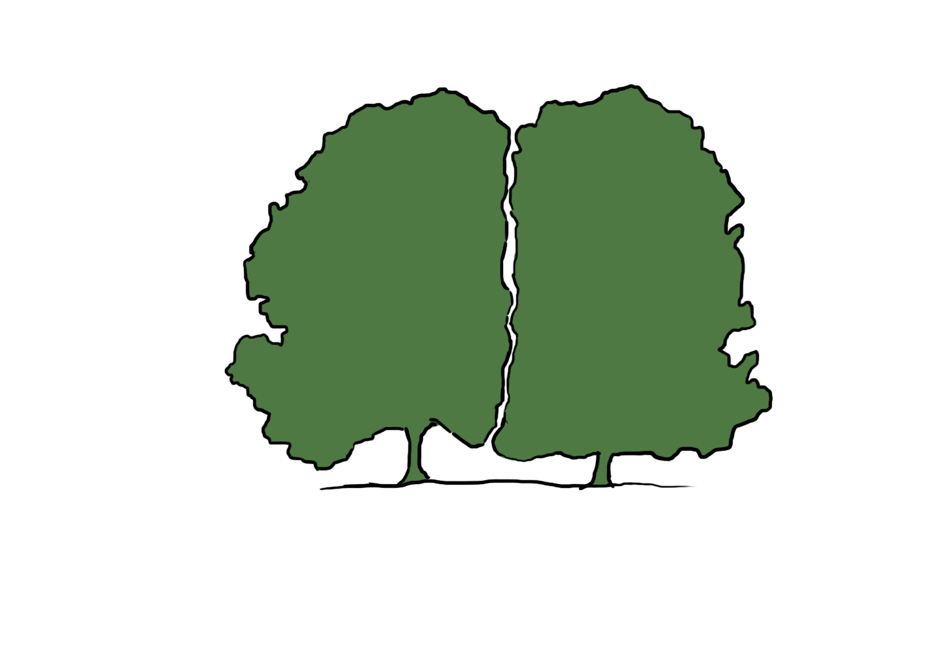
Plug-in goals

Slide 8
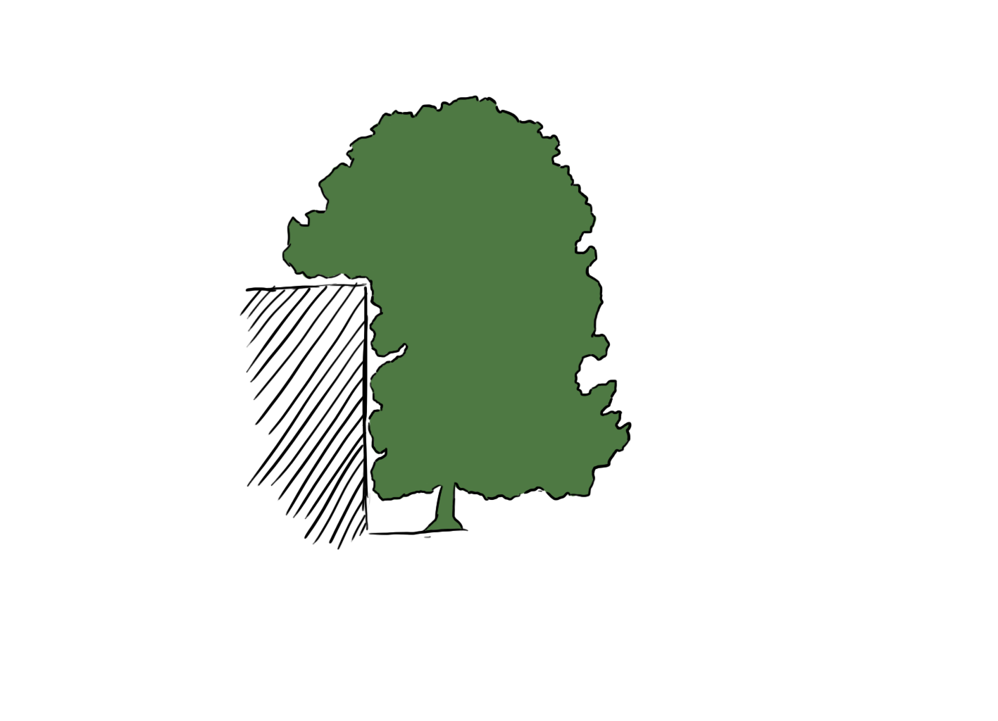
Plug-in goals

Slide 9
Plug-in goals

Slide 10
Approach

Slide 11
Procedural Plants
Fractal concept
Self similarity
Not true fractals
Finite
Oppenheimer, P. E. (1986).
Notes:
A fractal is a mathematical set that has a fractal dimension that usually exceeds its topological dimension
Fractals are usefull for describing nature because they deal with roughness rather than maths which deals with smoothness & regualrity.
Fractal length is therefore infinite where as plants are finite

Slide 12
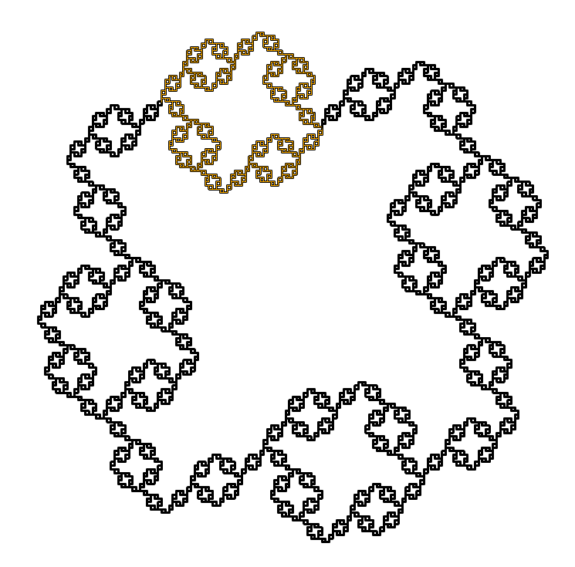
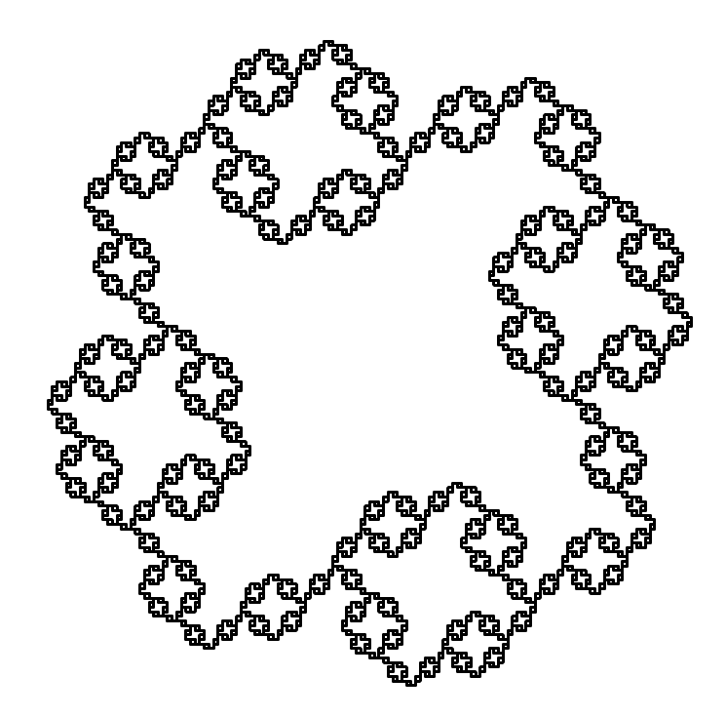
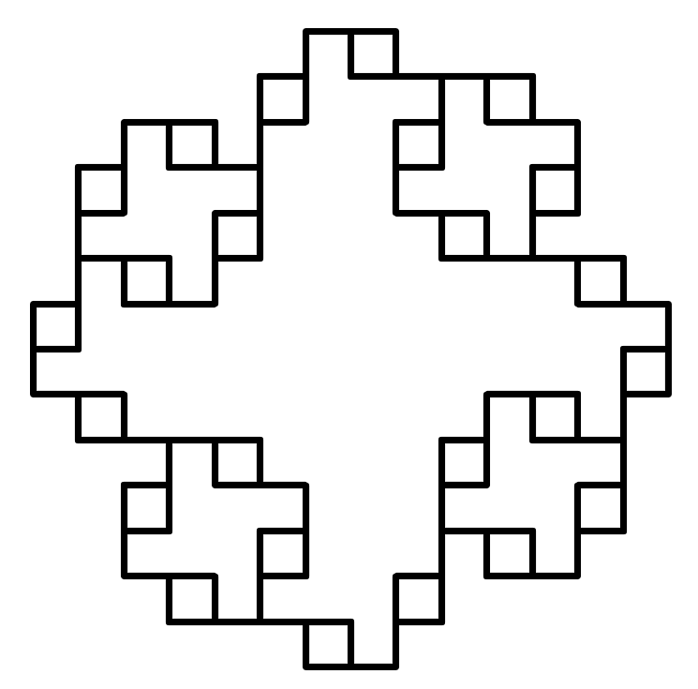
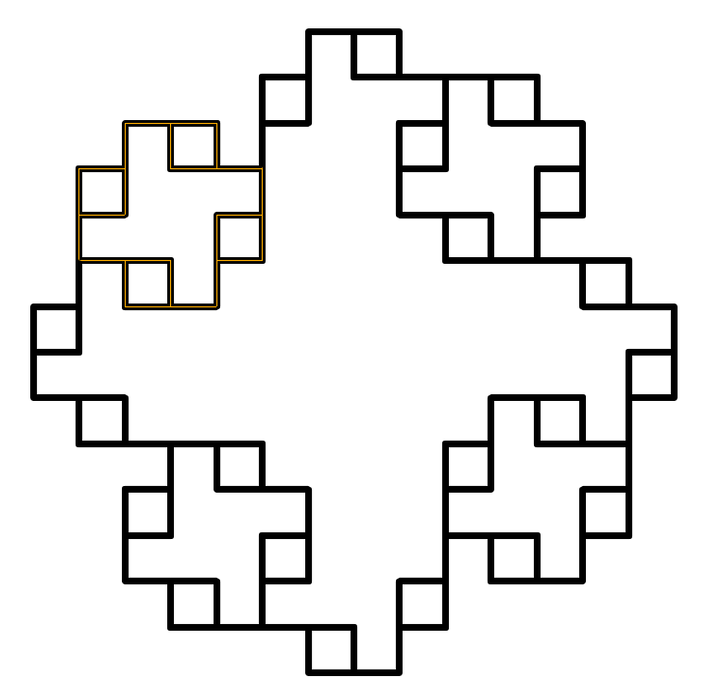
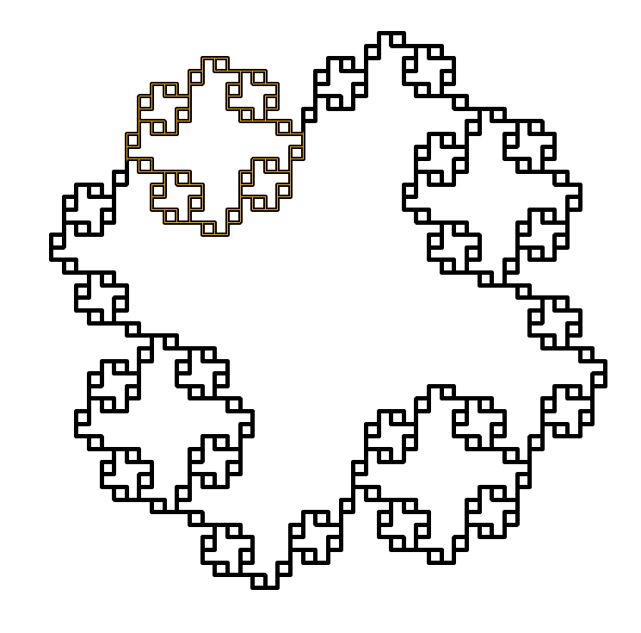
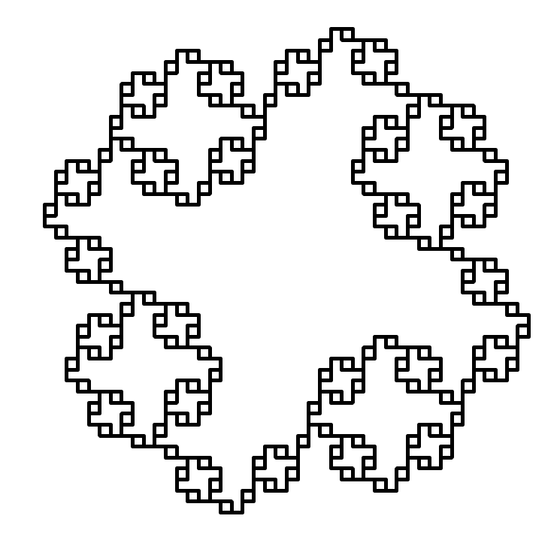
Self similarity

Slide 13
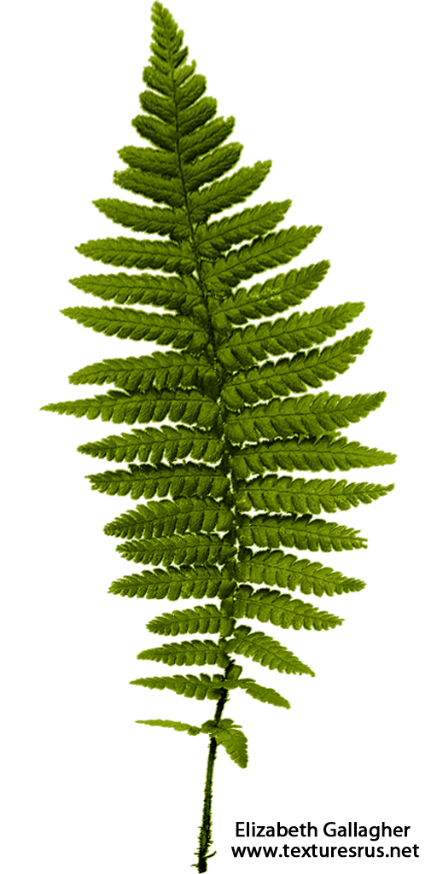
Plant Fractals
Good for:
http://trutextures.blogspot.co.uk/2012_03_01_archive.html

Slide 14
Plant Fractals
while (branches)
{
if (branchWidth < var)
{
draw leaf
}
else
{
}
}
Variables:
Stem width
Stem length
Branch angle
Divide number
Twist angle
0.2
1.0
45°
2
30°
grow /
divide /
twist

Slide 15
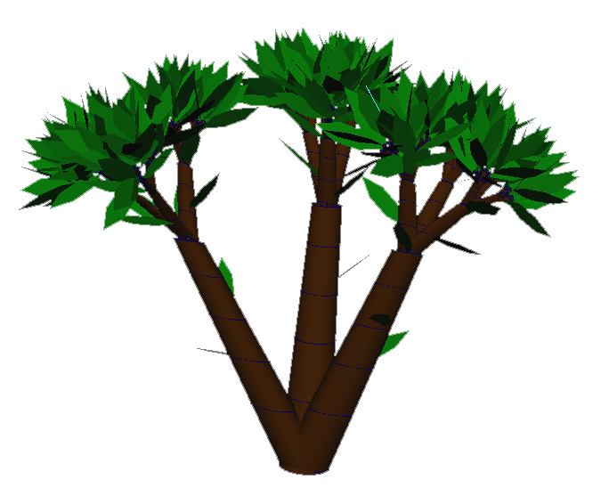
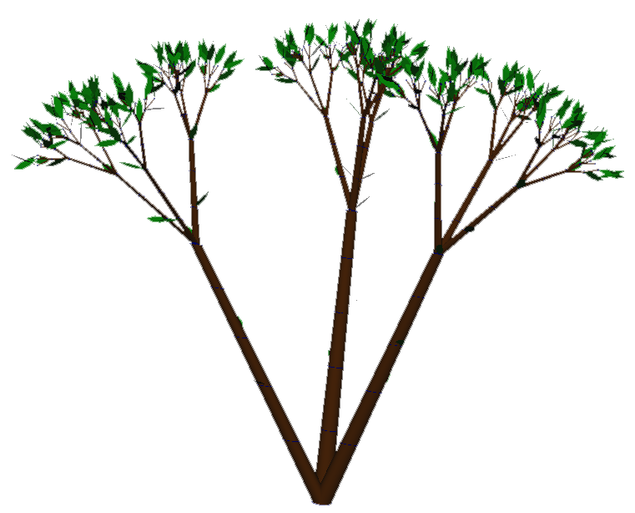
Statistically similar

Slide 16
Plant Fractals
Stochastic variance
while (branches)
{
if (branchWidth < var)
{
draw leaf
}
else
{
grow / divide / twist ... etc
}
}
Variables:
Stem width
Stem length
Branch angle
Divide number
Twist number
0.2
1.0
45°
2
30°
± 0.05
± 0.2
± 15
± 1
± 10

Slide 17
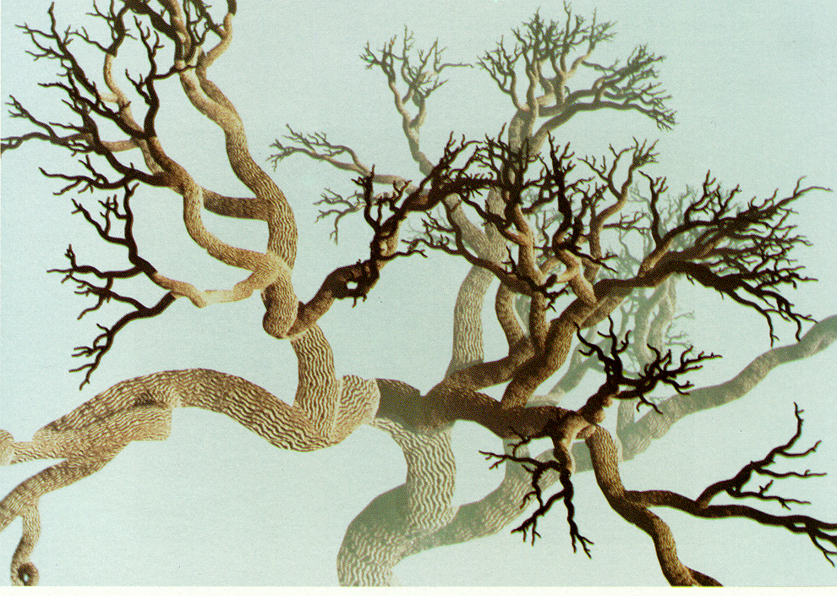
Plant Fractals
Stochastic variance
Oppenheimer (1986)

Slide 18
L-Systems
String rewriting
Axiom (ω)
Generations
Processors
Predecessor → Successor
Final string
Alphabet
F
2
F → F-F
F-FF-F
F+-&\/{}[]
Prusinkiewicz & Lindenmayer (1990)
Notes:
According to Kolmogorov [80], the complexity of an object can be measured by the length of the shortest algorithm that generates it. In this sense, many fractals are particularly simple objects.

Slide 19
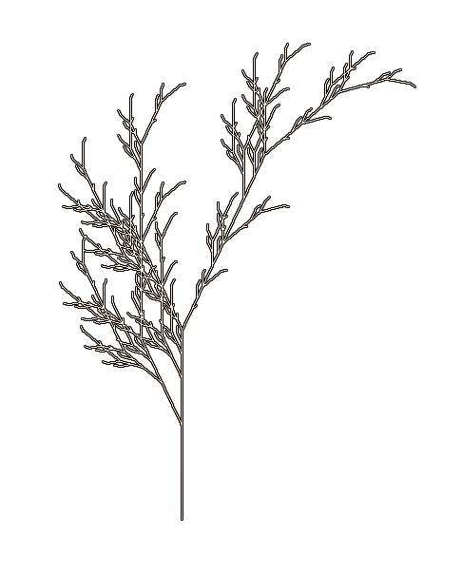
L-Systems
Create fractal approximations

Slide 20
L-Systems
Context-sensitive
b < a → b
a → a
b → a
ω = baa
p₁ = aba
p₂ = aab

Slide 21
L-Systems
Context-sensitive
Stochastic
F → F + [-F]
F → FF - FF
F → F + [-F]
0.4
0.4
0.2

Slide 22
Environment

Slide 23
Voxel space
Greene (1989)

Slide 24
Voxel space

Slide 25
Growth avoidance

Slide 26
Growth avoidance
Notes:
As the l-systems are grown I will change the voxels that it passes through from empty to full

Slide 27
Growth avoidance

Slide 28
Growth avoidance

Slide 29
Growth avoidance

Slide 30
Growth avoidance

Slide 31
Growth avoidance
✗

Slide 32
Light availability

Slide 33
Light availability

Slide 34
Light availability

Slide 35
Light availability
Notes:
Next we see if a path can be traced from the voxel to the sky hemisphere traversing along the ray

Slide 36
Light availability
✗

Slide 37
Light availability
✗
✗

Slide 38
Light availability
✗
✓
✗

Slide 39
Light availability
✗
✓
✗
✓

Slide 40
Light availability
✗
✓
✗
✓
0.5

Slide 41
Integrating with L-System

Slide 42
Modifying L-System
Light availability
Length
Override L-System
Don’t grow leaves < threshold
Stochastic weighting
Heliotropism
Direction of growth
Notes:
Produce leaf branch: Stochasitc L-system values are no longer based on probability but rather light intensity

Slide 43
Light availability
Rewrite while drawing
Stochastic L-System
Weighted probabilities
Voxel luminosity (L_{s})
F → F + [-F ]
F → F - FF
F → F + [-F]
0.33
L L
L
L_{S} = 0.5
0.33
L_{s}
0.34

Slide 44
Light availability
Rewrite while drawing
Stochastic L-System
Weighted probabilities
Voxel luminosity (L_{s})
F → F + [-F ]
F → F - FF
F → F + [-F]
0.33
L L
L
L_{S} = 0.8
0.33
L_{s}
0.34

Slide 45
Light availability
Rewrite while drawing
Stochastic L-System
Weighted probabilities
Voxel luminosity (L_{s})
F → F + [-F ]
F → F - FF
F → F + [-F]
0.7
L L
L
L_{S} = 0.8
0.2
L_{s}
0.1

Slide 46
Leaf problem
p₁

Slide 47
Leaf problem
p₂

Slide 48
Leaf problem
p₃

Slide 49
Leaf problem
p₃

Slide 50
Light availability
F → F + [-F ]
F → F - FF
F → F + [-F]
0.7
L L
L
L_{S} = 0.8
0.2
L_{s}
0.1

Slide 51
Light availability
F → F + [-F ]
F → F - FF
F → F + [-F]
0.7
L L
L
p₃
0.2
L_{s}
0.1

Slide 52
Light availability
F → F + [-F ]
F → F - FF
F → F + [-F]
0.7
L L
L
p₁
0.2
L_{s}
0.1

Slide 53
Light availability
F → F + [-F ]
F → F - FF
F → F + [-F]
0.1
L L
L
p₁
0.3
L_{s}
0.6

Slide 54
Heliotropism
0.0
0.1
0.2
0.1
0.3
0.7
0.5
0.8
0.9

Slide 55
Heliotropism
0.1
0.2
0.8
0.5

Slide 56
Heliotropism
0.3

Slide 57
Heliotropism
0.3

Slide 58
Heliotropism
0.8

Slide 59
Sampling

Slide 60
Why random sampling?
Shirley, P. (1991)

Slide 61
Why random sampling?
Errors
Error patterns

Slide 62
Random Sampling
Z
X

Slide 63
Random Sampling
Random

Slide 64
Pseudo-Random Sampling
Jittered
Notes:
Good for small samples and when working in 2 dimensions

Slide 65
Pseudo-Random Sampling
N-rooks
Notes:
Each row and colum will have one samepl

Slide 66
Pseudo-Random Sampling

Slide 67
Potential improvement

Slide 68
Quadtree
Meagher (1981)

Slide 69
Quadtree
n = 1
n = 1

Slide 70
Quadtree

Slide 71
Quadtree
n$=\frac{3}{4}$

Slide 72
Quadtree

Slide 73
Quadtree
n$=\frac{9}{16}$

Slide 74
What Programming Language?

Slide 75
Python or C++
String re-writing
time.time()
θ = 90º
ω = F
F → FF-[-F+F+F]+[+F-F-F]
Gen: 1 - 7
n = 10
2 Tailed TTest
Notes:
Using time.time as timeit does not work in this instance as I need to collate the args and pass them to the .mll plugin

Slide 76
Results - Graphed

Slide 77
Results - Graphed

Slide 78
Results - Data
 |  | Mean Processing Time (sec)
 |  | C++ | Python
Generation | 1 | 0.005 | 0.000
 | 2 | 0.004 | 0.008
 | 3 | 0.005 | 0.039
 | 4 | 0.008 | 0.180
 | 5 | 0.027 | 1.345
 | 6 | 0.097 | 39.611
 | 7 | 0.574 | 2705.670

Slide 79
Results - Data
 |  | Mean Processing Time (sec) ±SD
 |  | C++ | Python
Generation | 1 | 0.005 ± 0.002 | 0.000 ± 0.001
 | 2 | 0.004 ± 0.002 | 0.008 ± 0.002
 | 3 | 0.005 ± 0.001 | 0.039 ± 0.014
 | 4 | 0.008 ± 0.002 | 0.180 ± 0.009
 | 5 | 0.027 ± 0.009 | 1.345 ± 0.017
 | 6 | 0.097 ± 0.013 | 39.611 ± 0.143
 | 7 | 0.574 ± 0.011 | 2705.670 ± 18.417

Slide 80
Results - Data
 |  | Mean Processing Time (sec) ±SD
 |  | C++ | Python | T-Test
Generation | 1 | 0.005 ± 0.002 | 0.000 ± 0.001 | < 0.05
 | 2 | 0.004 ± 0.002 | 0.008 ± 0.002 | < 0.05
 | 3 | 0.005 ± 0.001 | 0.039 ± 0.014 | < 0.05
 | 4 | 0.008 ± 0.002 | 0.180 ± 0.009 | < 0.05
 | 5 | 0.027 ± 0.009 | 1.345 ± 0.017 | < 0.05
 | 6 | 0.097 ± 0.013 | 39.611 ± 0.143 | < 0.05
 | 7 | 0.574 ± 0.011 | 2705.670 ± 18.417 | < 0.05

Slide 81
Results - Data
 |  | Mean Processing Time (sec) ±SD
 |  | C++ | Python | T-Test
Generation | 1 | 0.005 ± 0.002 | 0.000 ± 0.001 | < 0.05
 | 2 | 0.004 ± 0.002 | 0.008 ± 0.002 | < 0.05
 | 3 | 0.005 ± 0.001 | 0.039 ± 0.014 | < 0.05
 | 4 | 0.008 ± 0.002 | 0.180 ± 0.009 | < 0.05
 | 5 | 0.027 ± 0.009 | 1.345 ± 0.017 | < 0.05
 | 6 | 0.097 ± 0.013 | 39.611 ± 0.143 | < 0.05
 | 7 | 0.574 ± 0.011 | 2705.670 ± 18.417 | < 0.05

Slide 82
Current stage

Slide 83
Workflow – Idea development
Area of interest
Literature review
Project Idea
L-System
Notes:
After working with this for some time I felt i could scope out a feasable project idea

Slide 84
L-System current features
3D
Local axis rotation
MyMath
Stem and leaf generation

Slide 85
L-System current features

Slide 86
aleeuwenberg.weebly.com
Blog

Slide 87
Next stage

Slide 88
Work Flow – Gantt Chart

Slide 89
Key upcoming tasks
Stochastic L-System
N-rooks sampler
Voxel space
Preventing growth
Calculating light
Combine features

Slide 90
Plug-in specifications
UI
Axiom & Processors
Variable manipulation
Advanced settings (scatter number etc.)
Target audience
Write L-System rules

Slide 91
Build timetable
Alpha : 21st March
Stochastic L-System
Voxel growth
Heliotropism
Beta : 21st March →
Bug fixes
Refinement
Octree

Slide 92
Summary
Generate forest scene
L-Systems
Voxel
Space occupation
Light availability
Heliotropism
C++ API
Currently
Next stage

Slide 93
References
Dippe, M, A, Z. (1985). Antialiasing Through Stochastic Sampling. ACM SIGGRAPH Computer Graphics. 19 (3). 69-78.
Greene, N. (1989). Voxel Space Automata: Modelling with Stochastic Growth Processes in Voxel Space. SIGGRAPH '89 Proceedings of the 16th annual conference on Computer graphics and interactive techniques , 23 (3), 175 – 184.
Kensler, A. (2013). Correlated Multi-Jittered Sampling. Pixar Technical Memo
Meagher, D. (1981). Geometric Modeling Using Octree Encoding. Computer Graphics and Image Processing , 19, 129-147.
Oppenheimer, P. E. (1986). Real time design and animation of fractal plants and trees. ACM SIGGRAPH Computer Graphics , 20 (4), 55-64.
Prusinkiewicz, P., & Lindenmayer, A. (1990). The Algorithmic Beauty of Plants. New York: Springer-Verlag.
Shirley, P. (1991). Discrepancy as a Quality Measure for Sample Distributions. Proceedings of Eurographics. 183-193.

Slide 94
Questions
please

